Slide 1
APUSH/Turning Points Introduction 2019-2020
Dalton Edwards
Heritage High School
Advanced Placement US History/
Turning Points in American History

Slide 2
Bell Ringer
Join Remind 101
3rd period: Enter 81010 into your phone and text this message: @ckcfbeb9
Join Google Classroom
3rd period Code: jd7vif
Check out a Brinkley Textbook

Slide 3
Introduction
Mr. Edwards
dedwards4@wcpss.net
dedwardsushistory.weebly.com
Room 2522
Office Hours-Tuesday 2:30-3:30

Slide 4
Course Overview
The AP U.S. History course focuses on developing students’ understanding of American history from approximately 1491 to the present.
The course has students investigate the content of U.S. history for significant events, individuals, developments, and processes in nine historical periods; periods organized around Key Concepts
The course also provides seven themes that students explore throughout the course in order to make connections among historical developments over time.
The course demands that students develop and use the same historical thinking skills and methods over time.
AP U.S. History is designed to be the equivalent of a two-semester introductory college or university U.S. history course.
AP U.S. History will meet on an A/B schedule paired with Turning Points in American History.

Slide 5
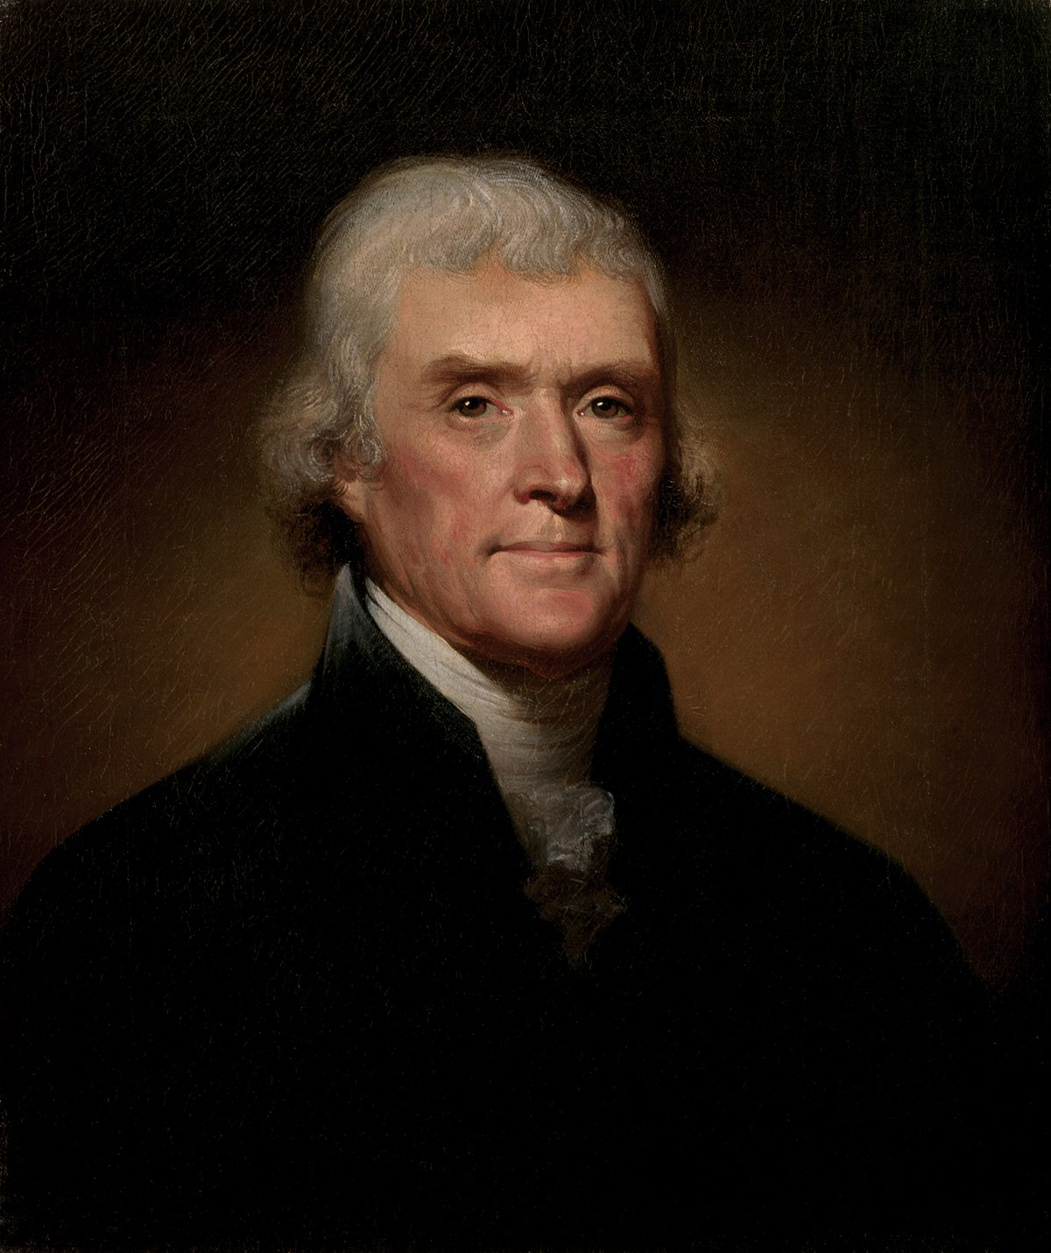
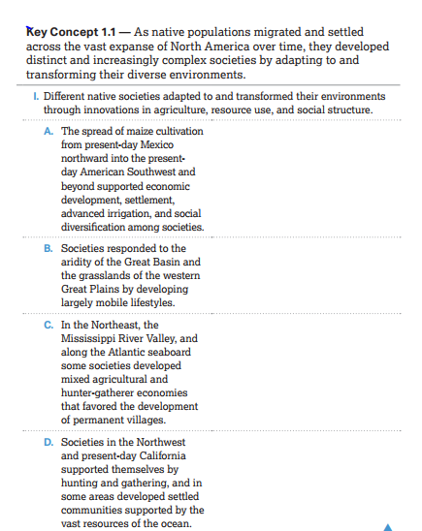
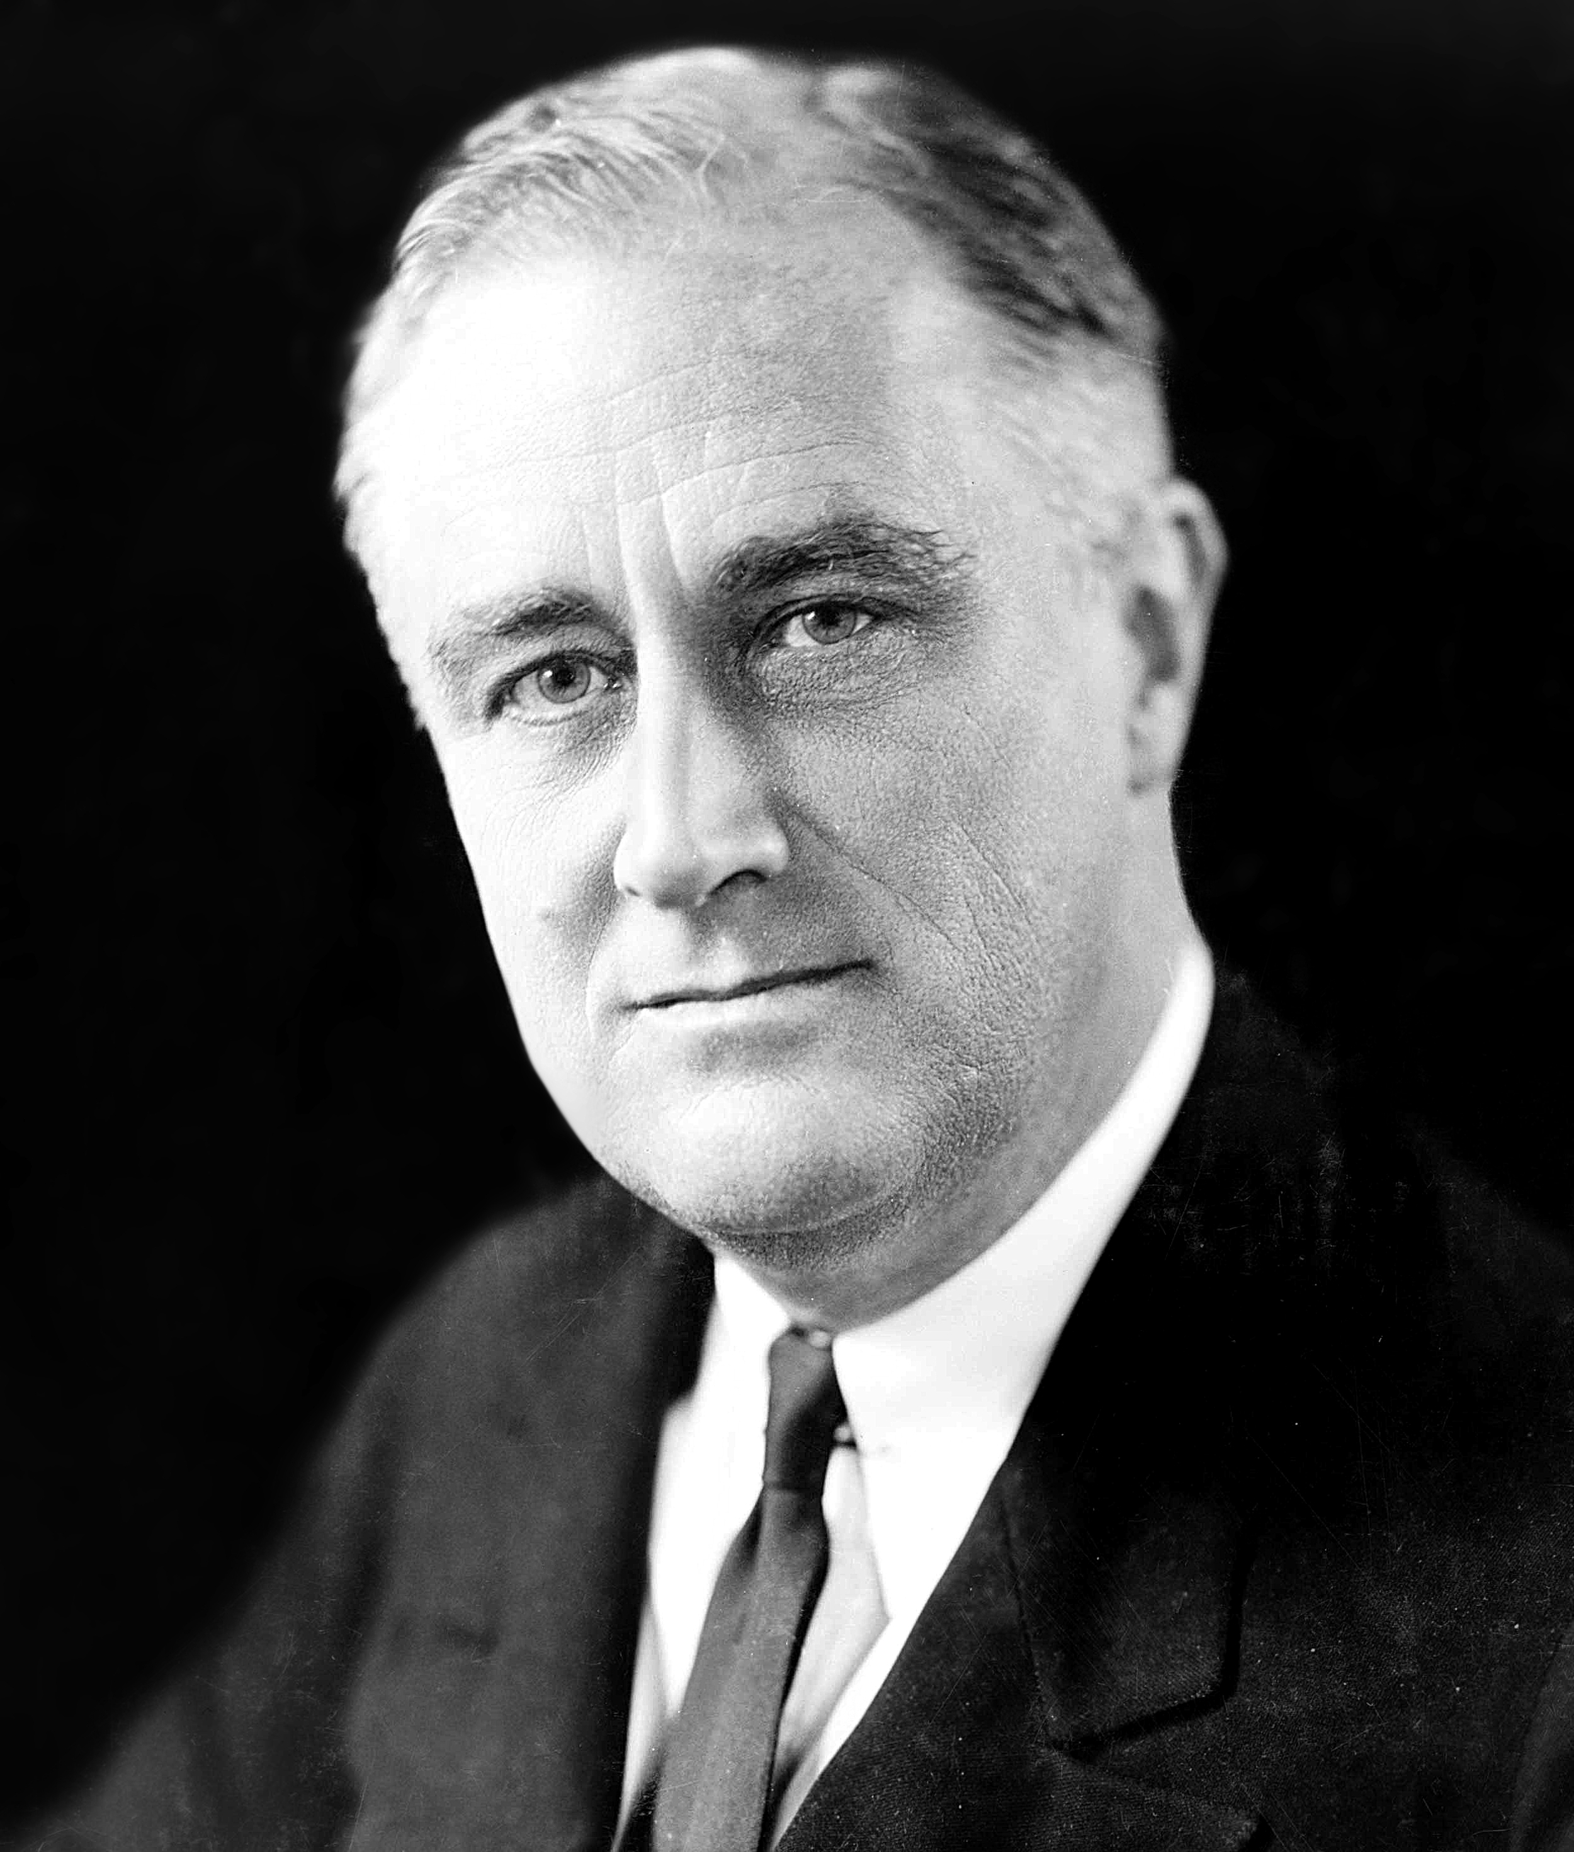
APUSH Units/Key Concepts
Period 1 (1491-1607)
Period 2 (1607-1754)
Period 3 (1754-1800)
Period 4 (1800-1848)
Period 5 (1844-1877)
Period 6 (1865-1898)
Period 7 (1890-1945)
Period 8 (1945-1980)
Period 9 (1980-Present)

Slide 6
Historical Themes
American and National Identity (NAT)
Politics and Power (POL)
Work, Exchange, and Technology (WXT)
Culture and Society (CUL)
Migration and Settlement (MIG)
Geography and the Environment (GEO)
America in the World (WOR)

Slide 7
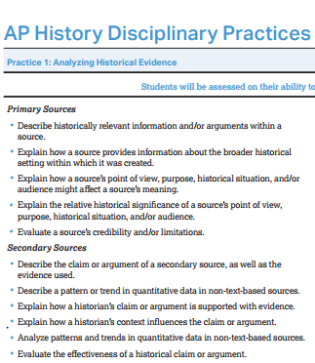
Historical Thinking Skills
AP History Disciplinary Practices
Analyzing Historical Evidence
Argument Development
AP History Reasoning Skills
Contextualization
Comparison
Causation
Continuity and Change

Slide 8
APUSH Introduction Gallery Walk
Directions: Choose at least one photograph/portrait located around the classroom to answer each of the following questions. Use the APUSH course description linked to the class web page to assist your responses (dedwardsushistory.weebly.com)

Slide 9
Course Design
AP U.S. History will meet on an A/B schedule paired with Turning Points in American History.
Units will closely align with the periodization of the AP College Board and include opportunities to understand Historical disciplinary practices and develop Historical reasoning skills.
Each unit is concluded with an exam consisting of multiple-choice questions, and/or long essay (LEQ), short essay (SAQ), and Document Based Questions, (DBQ).
To equip students with the skills necessary to successfully complete the free-response section of the AP Exam, special focus is placed on the writing component of the course.

Slide 10
Grading Weights
Unit Tests/Major Projects/Papers 40%
Quizzes/Minor Projects 20%
Class Work 30%
Homework 10%

Slide 11
Class Discussions
Class discussions will be driven by assigned readings from the textbook and ancillary resources.
In order to participate in the discussions, you must be prepared with notes and/or completed guided reading assignments.
The goal each day is not only to understand the concepts, but to utilize the nine learning objectives described in the course description. Several of these objectives will be addressed each day; therefore it is imperative that you are prepared to engage in the discussions.

Slide 12
Unit Tests
While students are encouraged to help each other and work together, cheating will not be tolerated.
Exams will be given for each of the nine units in this course.
All exams will consist of a combination of multiple choice and short answer, long essay or Document Based Question (DBQ). All questions will be similar to questions found on the actual Advanced Placement exam.

Slide 13
AP Exam Description
The AP U.S. History Exam is 3 hours and 15 minutes long and includes both a 105-minute multiple-choice/short-answer section and a 90-minute free-response section. Each section is divided into two parts.
Exam Date: Friday, May 8, 8 AM Heritage High School
Students’ understanding of the thematic learning objectives will be assessed throughout the exam.
Students’ ability to utilize the historical thinking skills will be assessed throughout the exam.
Students’ understanding of all nine periods of U.S. history will be assessed throughout the exam.
No document-based question (DBQ) or long-essay question (LEQ) will focus exclusively on events prior to 1607 (Period 1) or after 1980 (Period 9).

Slide 14
AP Exam Description
Section | Question Type | Number of Questions | Timing | Percentage of Total Exam Score
I | Part A: Multiple-choice questions | 55 questions | 55 minutes | 40%
 | Part B: Short-answer questions | 3 questions | 40 minutes | 20%
II | Part A: Document-based question | 1 question | 60 minutes | 25%
 | Part B: Long essay question | 1 question among three from different periods (1–3, 4–6, 7–9) of the course. | 40 minutes | 15%

Slide 15
Grading of the AP Exam
An AP Exam score of 5 is equivalent to the average score among college students earning grades of A in the college course. Similarly, AP Exam scores of 4 are equivalent to college grades of A−, B+, and B. AP Exam scores of 3 are equivalent to college grades of B−, C+, and C.
5= Extremely Well qualified; 4=Well qualified; 3=Qualified; 2=Possibly qualified; 1=No recommendation

Slide 16
Homework
David McCullough Essay, “Knowing Who We Are”
Linked on APUSH homepage
Secondary Source Analysis Worksheet
Brinkley Reading with 4C Historical Reasoning Skill Graphic Organizer

Slide 17
Day 2 Agenda-Introduction
Analyzing Historical Evidence
Secondary Source using Source Analysis Worksheet
David McCullough, “Knowing History and Knowing Who we Are”
Introduction to Historiography
Primary Source using APPARTS
Lewis Hine, Child factory photograph
Text Reading & Note Taking using 4C’s Graphic Organizer
Alan Brinkley, American History

Slide 18
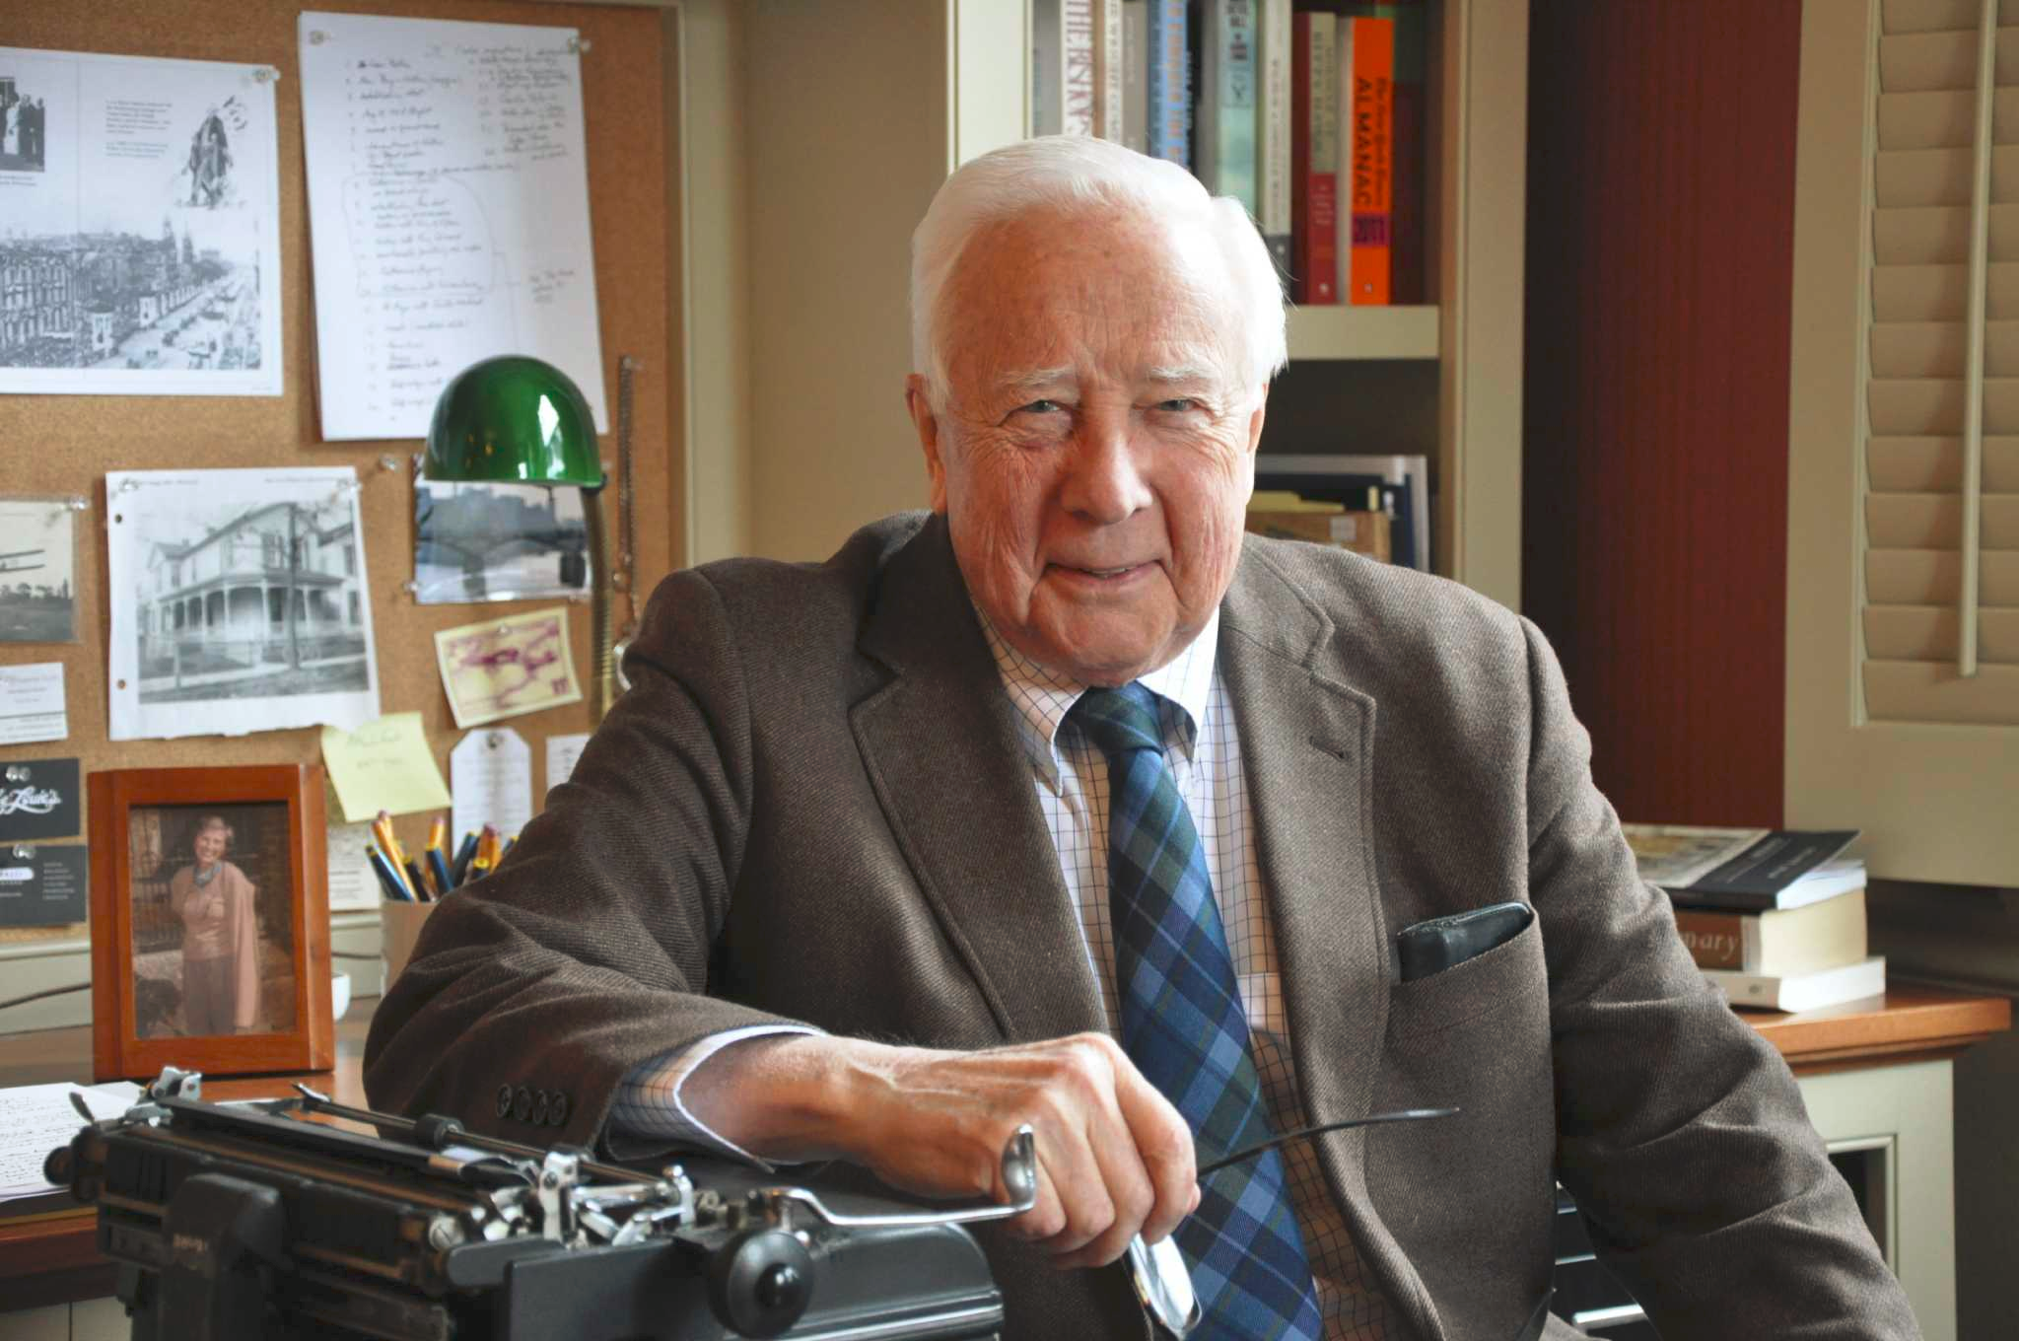
David McCullough ”Knowing History and Knowing Who We Are”
What is the author’s argument or main idea about this topic?
What specific examples does he use to support his argument or idea?

Slide 19
David McCullough ”Knowing History and Knowing Who We Are”
“We’re raising a lot of cut flowers, and trying to plant them.”
“They lived in the present, just like we do”
“[There is no] such creature as a self-made man or woman”
“To be indifferent to the past, is to be rude”
“We are not just known by our failings…we are known by being capable of rising to the occasion.”
“That’s very American. We will find out what’s not working right and we will fix it…”
“They were, as we would say, winging it.”
“It’s our best known scene from our past. And almost nothing about it is accurate.”
“Tell stories”
“You can’t understand the 18th century without understanding the language of the 18th century”.
“The Revolutionary War was as dark a time as we’ve ever been through”

Slide 20
Why Study History?
“Everything we have, all our great institutions, hospitals, universities, libraries, this city, our laws, our music, art, poetry, our freedoms, everything is because somebody went before us and did the hard work…indifference to history isn’t just ignorant, it’s rude. It’s a form of ingratitude.”
David McCullough

Slide 21
Why do Historians So Often Differ?
Historiography--the theory and history of historical writing; Historiography is the study of how history has been written and analyzed. Historians must consider the era, perspectives, and agendas of their primary and secondary sources as they determine historical arguments. “The history of history.”
Facts aren’t always clear
Facts mean little without someone’s interpretation of them
Political and Ideological disagreements
Diverse backgrounds
Differences in methodology
Times in which history is written (Context)
* See handout

Slide 22
Classroom Procedures
Google classroom: Google classroom will be used for you to pass in specific work when assigned.
Class website: The dedwards4.weebly.com site will be used for me to post specific classroom resources
Remind: Remind will be used to make class announcements from me to you. If you need to communicate to me, please send me an email at dedwards4@wcpss.net

Slide 23
Classroom Procedures
Make-Up Work
All assignments and activities that were passed out in your absence can be found on the day-folder wall. Check the wall, then a friend before asking me. Please don’t ask when class has begun and I’m teaching.
You are responsible for turning in work or taking a test/quiz/pop quiz on the day you return to school if it was announced prior to your absence.
Late Work
All assignments that are not turned in at the time due are considered late (unless you were absent).
Any assignment turned in late will receive a grade no higher than 60%.
All late work must be passed in by the late work deadline for each quarter.

Slide 24
Classroom Procedures
Test Retake policy: If a student receives a test grade below a 70, that student can retake the test within one week of the return date as long as they have all of their homework in for that unit and they attend teacher remediation within or outside of Husky Help. The test retake date will be determined by the teacher. Retakes take a different form than the initial test. If a student is absent on the retest day, their absence must be excused and they must take the test the day they return. A student may retest any test for a grade no higher than a 70.

Slide 25
Classroom Procedures
Quick Grades
Some homework and classwork will be graded quickly for completion and detail more so than accuracy:
Check/plus=90-100
Check=80-89
Check/minus=70-79
Check/minus/minus=60-69
Major Grades determined by more specific guidelines (i.e. rubrics for formal writing, multiple choice tests)

Slide 26
Classroom Procedures
If you need a tissue or to sharpen your pencil raise your hand and ask. Otherwise, wait for an appropriate time.
If you need to use the bathroom, ask me at the appropriate time. When I am teaching is not an appropriate time to ask. Always fill out a pass with your name, date and destination. I will sign it.
Food and drink are not allowed in the classroom; bottled or capped water is acceptable
Honor the BYOD protocol; Phone use unless authorized is prohibited. I can and will take your phone at any time given this understanding.

Slide 27
Class Supply List
1 ½ inch 3 Ring Binder
9 tabs for time periods
Highlighters
Colored pencils
Colored markers
Paper
Pens

Slide 28
APPARTS

Slide 29
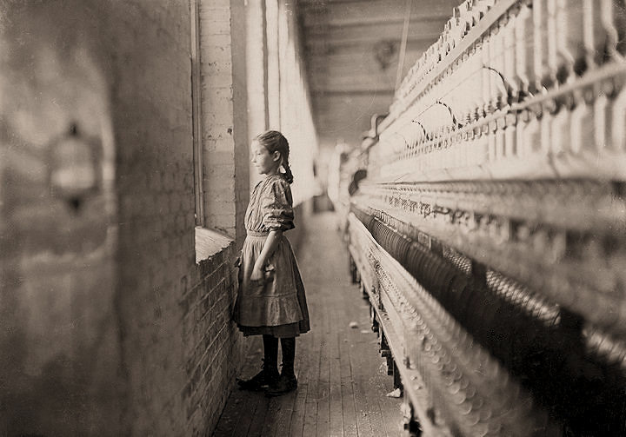
APPARTS

Slide 30
Notetaking
Your goal is to understand the key concepts of the Period we will study for each unit. You are strongly encouraged to take notes outside of class as part of your guided reading assignments.
Notetaking inside of class is a requirement.
Use a method of notetaking that makes sense to you:
Review the “READING BRINKLEY” sheet of suggestions.
Sticky notes highlighting major headings
Complete the KEY CONCEPTS Graphic Organizer for each Period

Slide 31
4Cs Graphic Organizer & Brinkley
Contextualization
Comparison
Continuity and Change Over Time
Causation

Slide 32
Unit Big Ideas & Brinkley Reading Guide
See Unit 1 and Unit 2 Handouts
Major Due Dates
Key Concepts
Reading Assignment dates

Slide 33
Identifications assignment
Read the guiding principles of the “how to complete identifications” sheet
For every unit of study, you will be asked to choose a “Top Ten” list of identifications to define in a specific way.
I reserve the right to modify the identifications list in order to best support the Key Concepts and themes of the unit.
Use the guiding principles to define yourself.
Be prepared to share out and pass in as a writing sample.
Use complete sentences.
Write a narrative (Tell a story)

Slide 34
Jigsaw Activity Using Secondary Sources
Red—Brinkley and AMSCO
Blue-Power Point-Americans Before Contact
Green-Shi and Tindall handout Part A
Yellow-Shi and Tindall handout Part B
Directions:
Read and interpret your assigned secondary source. Use the source to complete the KEY CONCEPT CHART for KC 1.1. What SFI (Specific Factual Information) can you use to support the concept stated?
Compare notes and share information to complete any part of the chart that you could not do individually
Be prepared to discuss with the whole class.
Remember the Essential Question for the day

