Slide 1
Constitutional Convention
September 1787

Slide 2
Class Assignment A:
While reviewing this presentation, complete the following assignments individually:
Fill in the Constitutional Compromises graphic organizer
On the back of the graphic organizer, answer the following questions:
Demographically, who were the delegates at the convention?
Whose argument was better justified-the Federalists or Anti-Federalists? Explain your answer.

Slide 3
Class Assignment B:
Use the chart of quotes comparing the beliefs of the Federalists and the Anti-federalists
Answer the questions that follow on the worksheet provided.

Slide 4
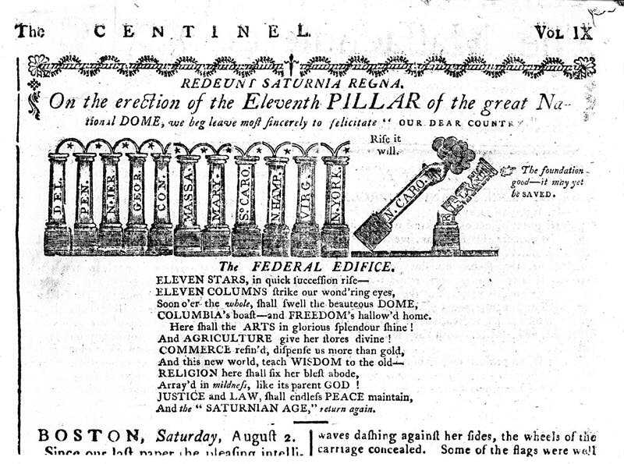

Slide 5
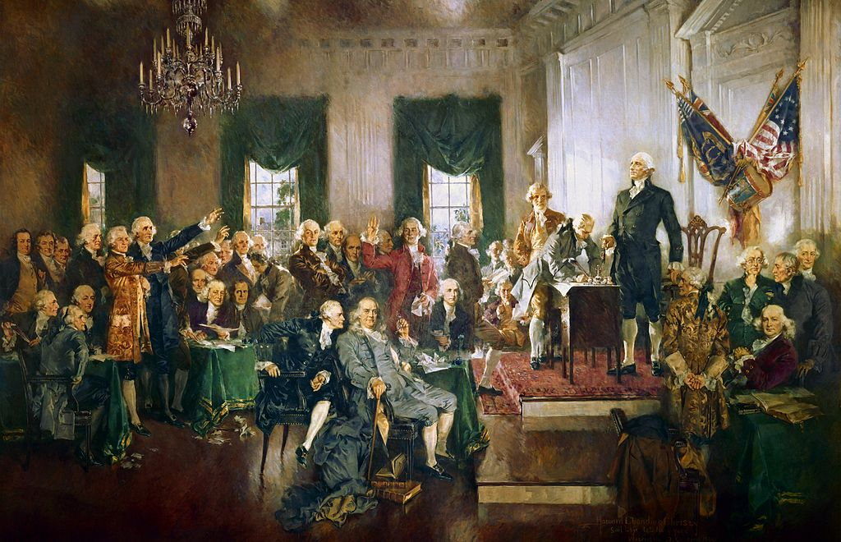

Slide 6
Brinkley
Who were some of the “advocates of centralization” or supporters of a strong national government during the 1780s?
Some military men, like the Society of Cincinnati, wanted to be paid their Revolutionary War pensions
American manufacturers wanted to replace state tariffs with a more uniform national duty
Merchants and shippers wanted to replace state commercial policies with one uniform one
Land speculators wanted Indians removed from western lands
People who were owed money wanted individual states to stop issuing currency and thus lowering the value of what they received
Investors in confederation securities wanted the government to fund their debt so their securities would increase in value
Property owners feared mob rule (like Shay’s Rebellion)

Slide 7
Brinkley
What role did Alexander Hamilton play in instituting a constitutional convention in Philadelphia?
Found an ally in James Madison to call for a convention
Madison persuaded VA delegates to call for a convention on interstate commerce
5 states sent delegates to the Annapolis Convention in Maryland in 1786
Delegates approved a proposal drafted by Hamilton (NY) recommending that Congress call a special convention to consider ways to revise the Articles of Confederation

Slide 8
I. The Road to the Constitution
A. The debate over the Articles of Confederation waged for ten years
1. Proposed Solutions
Solution #1—Combine the 13 independent states into one large state with one central government

Slide 9
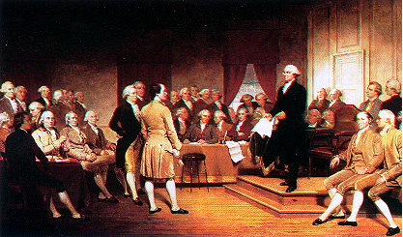
I. The Road to the Constitution
Solution #2—Develop a federal system, in which the power to govern would be divided between a national government and the states
"GEORGE WASHINGTON ADDRESSING THE CONSTITUTIONAL CONVENTION" Oil, by Junius Stearns, c 1856. Virginia Museum of Fine Arts.

Slide 10
I. The Road to the Constitution
Constitutional Convention, 1787
“We have here at present what the French call une assemble des notable, a convention composed of some of the principal people from the several states of our Confederation”…Ben Franklin
“an assembly of demi-gods”…Thomas Jefferson observing from Paris

Slide 11
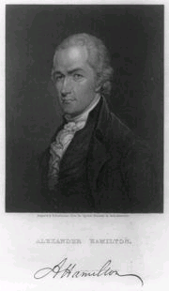
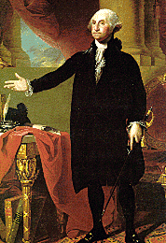
Franklin, Hamilton, Washington

Slide 12
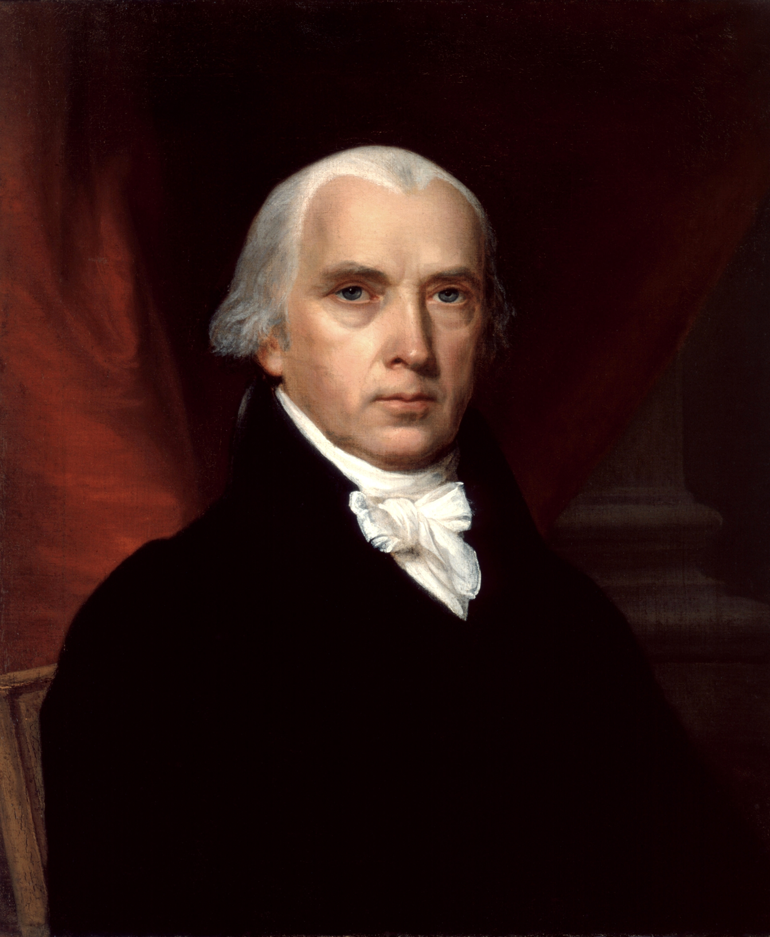
Brinkley-James Madison
What were the two important philosophical questions that Madison helped answer at the Constitutional Convention? How were they answered?
Where did ultimate sovereignty lie between a national government and a state government?
How can the new government avoid concentrated authority?

Slide 13
I. The Road to the Constitution
George Washington
Most prominent “demi-god”
Arrived in Philadelphia on May 13
Senior officers of the continental army and citizens on horseback greeted him on the outskirts of the city and formed an escort
Guns fired a salute and the bells of Christ Church rang out
55 years old; suffered from rheumatism
Did not want to risk his reputation in an effort that might be doomed to fail

Slide 14
I. The Road to the Constitution
George Washington
Had resigned his military commission in December 1783; intent on retirement
Friends urged him to come to Philadelphia to lend his influence and prestige to the convention
Washington thought that a refusal to go would be interpreted as his rejection of the convention
Decided to go out of a sense of duty
No one doubted that he would be elected the presiding officer of the convention
Motion made by Robert Morris of Pennsylvania and seconded by John Rutledge from South Carolina
Voted on unanimously

Slide 15
I. The Road to the Constitution
James Madison
First of the Virginia delegation to arrive in Philadelphia on May 3, 1787 from New York, where he had been serving in Congress
36 years old from Montpelier in Orange County, Virginia
Slight man, 5-6, shy and bookish
Close friend of Thomas Jefferson
What we know about the convention comes from Madison’s meticulous notes

Slide 16
I. The Road to the Constitution
Benjamin Franklin
81 years old and suffering from gout and gall stones that made it impossible for him to walk
Had returned in 1785 from Paris where he had been an American minister; planned to retire
Members of the Supreme Executive Council of Pennsylvania asked him to accept the post of president (governor)
In late March 1787 he accepted a commission to attend the constitutional convention in his hometown

Slide 17
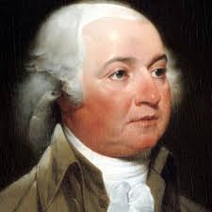
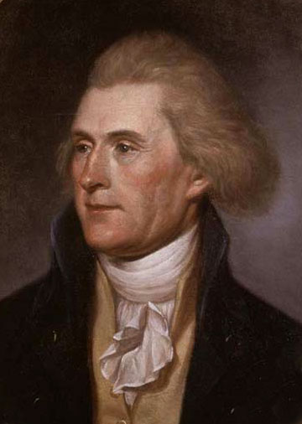
I. The Road to the Constitution
The men not there
John Adams was American minister in London
Thomas Jefferson was American minister in Paris
Both men’s presence was felt:
Adams had recently published A Defense of the Constitutions of Government in the United States
Jefferson exchanged letters with Madison and sent him books on constitutional theory and history

Slide 18
I. The Road to the Constitution
The Constitutional Convention (May-September 1787, Philadelphia)
A total of 55 delegates from 12 states were in attendance
Rhode Island sent no delegate because it opposed a stronger central government (beginnings of conflict between large and small states)
Original intent was to revise the Articles of Confederation
Quickly realized that the Articles were not worth saving; began to develop a new document— The Constitution —that would set up a central government

Slide 19
I. The Road to the Constitution
The Constitutional Convention (May-September 1787, Philadelphia)
Ruled that “nothing spoken in the House be printed, or otherwise published, or communicated without leave.”
Armed sentries were posted in the hall just outside the assembly room and on the street outside the State House.
A few delegates kept private records anyway; best record came from James Madison
Madison’s notes would be published in 1840; used by historians and constitutionalists to determine the intent of the founding fathers in framing the constitution

Slide 20
Pennsylvania State House/Independence Hall
Federal Hall, The Seat of Congress. Amos Doolittle (1754-1832). Engraving, 1790. Library of Congress, Prints and Photographs Division. Reproduction Number: LC-USZ62-333.

Slide 21
I. The Road to the Constitution
Demographic Make-up of Delegates
Historian James MacGregor Burns…it was a convention of “the well-bred, the well-fed, and the well-wed.”
All were white men
Most were professional and businessmen, rather than farmers and laborers
More than half of the delegates were under the age of 40
More than half were slaveholders
Half were college graduates and had experience in government
Several had been active in the fight for independence

Slide 22
I. The Road to the Constitution
Early Decisions
Each state would have only one vote, regardless of the number of delegates it sent to the Convention.
Issues would be decided by a simple majority vote (in this case, seven votes were needed to approve anything)
The debate in the Convention would be kept secret
Kept public pressure off the delegates
Allowed delegates to speak freely—they did not have to worry about reaction of their constituency
Result—we have no official records of the Convention

Slide 23
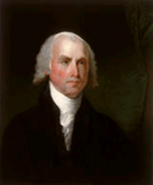
II. Creating and Ratifying the Constitution
Two Plans of Government
The Virginia Plan —proposed by Virginia governor Edmund Randolph, but written by James Madison
1. This plan included a “national executive”, “national judiciary”, and a bicameral legislature called Congress.
2. Representation in both the upper and lower house of the legislature would be based on population of each state—more populous states would have more representation than less populous states.
3. Lower house elected by the people; upper house chosen by the lower

Slide 24
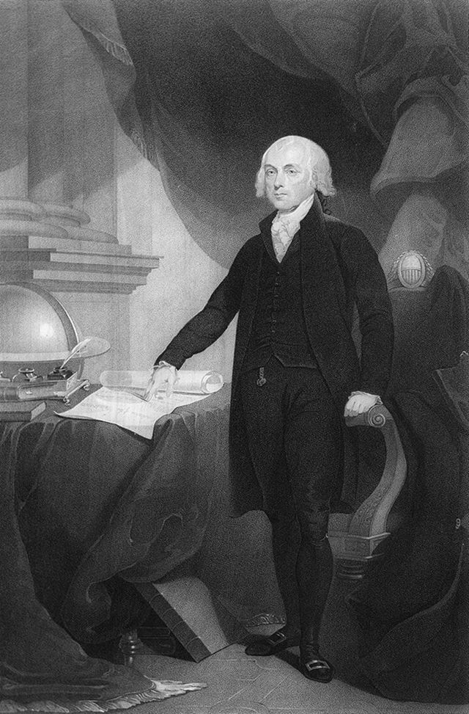
Creating the Constitution
The Virginia Plan (James Madison and VA Delegates)
Executive Branch (Powerful President)
Legislative Branch
House of Representatives
Senate
Judiciary (Federal Courts)
# of Reps Based on State Population
# of Reps Based on State Population
Father of the Constitution

Slide 25
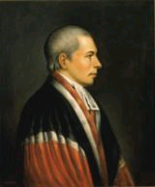
II. Creating and Ratifying the Constitution
New Jersey Plan—proposed by William Patterson from New Jersey as an alternative
1. Proposed out of fear that large states would dominate Congress and small states would have little power
2. Plan included a federal executive (consisting of more than one person), a federal judiciary, and a federal legislature called Congress which would be a unicameral body with equal representation for each state
3. Was similar to the government under the Articles of Confederation

Slide 26
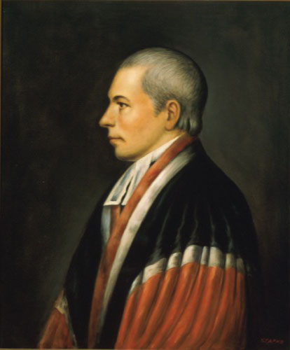
Creating the Constitution
The New Jersey Plan (William Patterson from NJ)
Feared large states would dominate Congress
Similar to Articles of Confederation
Legislative Branch (unicameral)
Executive Committee
# of Reps equal for all states
No power to veto state laws
More than one person

Slide 27
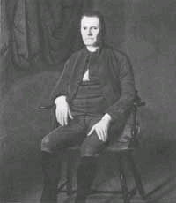
II. Creating and Ratifying the Constitution
The Great Compromise (The Connecticut Compromise) proposed a bicameral legislature
1. Representation in the lower house would be based on population- House of Representative
2. Representation in the upper house would be equal- Senate
Its chief virtue-it satisfied neither the small states or the large states
Alexander Hamilton called it a “motley measure”
James Madison called it a “novelty”
Agreed upon with a 5-4 vote
Roger Sherman

Slide 28
II. Creating and Ratifying the Constitution
How will Congress be chosen?
a. Many delegate feared popular elections. Considered the masses too easy swayed by popular passion.
b. Senators would be elected by the state legislators
c. Members of the House of Representatives would be elected directly by the people.

Slide 29
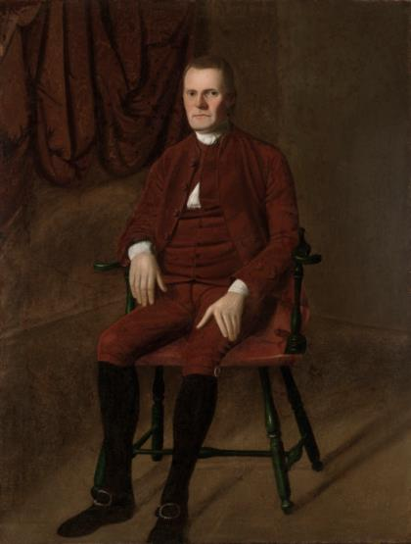
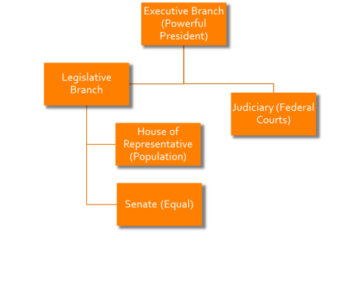
Creating the Compromise

Slide 30
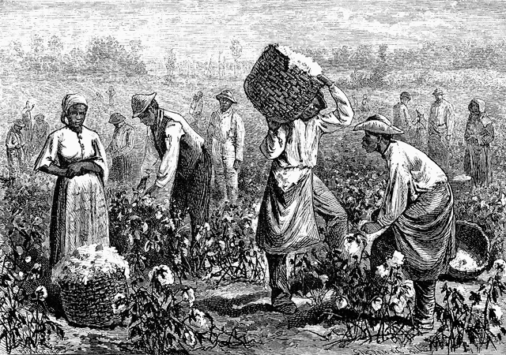
II. Creating and Ratifying the Constitution
Three-Fifths Compromise
1. In an effort to increase their power in the House of Representatives, southern states wanted slaves counted as part of their population
2. This idea was opposed by northern states that had fewer slaves
3. In the compromise, enslaved persons would be counted as 3/5 of other persons
4. This number would be used to determine representation and taxes

Slide 31
II. Creating and Ratifying the Constitution
Commerce and Slave Trade Compromise- Northerners wanted Congress to regulate foreign and interstate trade. Southerners feared taxes on exports and slowing of slave trade.
1. Congress would regulate interstate commerce and international trade
2. Congress could not tax exports
3. Congress could not interfere with the slave trade for 20 years

Slide 32
II. Creating and Ratifying the Constitution
How will the President be chosen?
a. Option #1—President will be chosen by members of Congress
b. Option #2—President will be elected by the people
c. Compromise—delegates decided on a system called the Electoral College where each state legislature would choose a number of electors who would select the President and Vice President

Slide 33
II. Creating and Ratifying the Constitution
Convention appointed a Committee of Style and Arrangement to draft the Constitution
James Madison (VA)
Alexander Hamilton (NY)
Rufus King (SC)
Gouverneur Morris (PA)
Largely fell upon Gouverneur Morris
One of the last sections he composed was the Preamble; stylistic change from “We the People” of named states to “We the People of the United States”

Slide 34
II. Creating and Ratifying the Constitution
When the Committee of Style presented its final draft to the convention, there were several objections:
George Mason (VA) demanded a Bill of Rights; after delegates voted that it was too late to add one he stated that he “would sooner chop off his right hand than put it to the Constitution”
Edmund Randolph who first proposed the VA Plan doubted that his state would approve it and refused to sign
Elbridge Gerry (Massachusetts) that that members of the Senate would hold offices too long and that Massachusetts would not be fairly represented in the House of Representatives. He refused to sign.

Slide 35
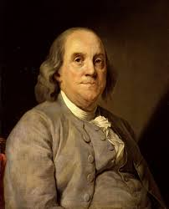
II. Creating and Ratifying the Constitution
Ben Franklin also objected to the Constitution but put an end to the speculation
He asked James Wilson to read a speech:
“I confess that there are several parts of this constitution which I do not at present approve, but I am not sure I shall never approve them: For having lived long, I have experienced many instances of being obliged by better information or fuller consideration, to change opinions even on important subjects, which I once thought right, but found to be otherwise…Thus I consent, Sir, to this Constitution because I expect no better, and because I am not sure, that it is not the best.”

Slide 36
II. Creating and Ratifying the Constitution
Delegates signed the Constitution on September 17, 1787 and decided it would take nine out of the thirteen states to ratify the document
By the end of October, the tide was turning against the Constitution
VA-Richard Henry Lee and Patrick Henry announced that they would work against ratification; Lee said that the Constitution was the work of “the artful and ever active aristocracy”; angered by the wording of the Preamble; and agreed with George Mason that there needed to be a Bill of Rights
MA-James Winthrop published letters under the pseudonym, “Agrippa”, charging that the Constitution gave too much power to the central government

Slide 37
II. Ratifying the Constitution
Anti-federalists:
In NY on September 27, newspapers published a series of attacks against the Constitution and the Philadelphia Convention:
Used the pseudonym “CATO”, “Sydney”, “Brutus”
Long thought to be New York’s antifederalist governor, George Clinton, and his supporters

Slide 38
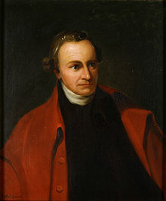
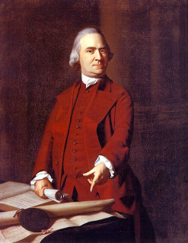
Anti-Federalists
Opposed the Constitution
Felt it gave too much power to the national government
Too much like the King and Parliament
Took too much power away from the states
Wanted a Bill of Rights Added To guarantee basic liberties
Articles of Confederation needed to be fixed, not thrown away
Made up of small farmers and poor merchants
Wrote a series of essays (Anti-Federalist Essays)
Discouraged ratification of the Constitution

Slide 39
Brinkley-Federalists
What advantages did the Federalists have over the Anti-Federalists?

Slide 40
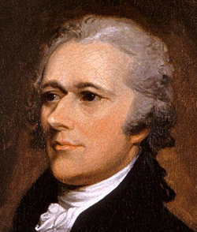
Federalists
Alarmed by the “anti-Federalist” letters, Alexander Hamilton decided to mount a campaign to reply
Eighty-five letters from “Publius”
55 written by Hamilton
29 by Madison
5 by John Jay
Hamilton arranged that the letters by printed in book form and on May 28, 1788, a 2 volume edition of The Federalist was published in New York

Slide 41
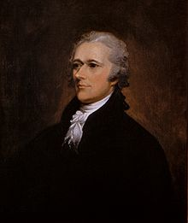
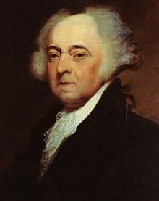
Federalists
Supported the Constitution
Nation couldn’t survive without a strong national government
Proof: Articles of Confederation
Did not think a bill of rights was necessary
Made up of mainly Large farmers, rich merchants and artisans
“The Federalist” Papers
Written by James Madison, John Jay, and Alexander Hamilton
Defended the constitution and attempted to persuade citizens to vote for ratification

Slide 42
Federalists
Anti-Federalists
President | Strong leader for nation | Feared would become dictator
Role of Congress | Strong Congress to make laws for nation | State legislatures to have most power
Courts | Handle disputes that affect nation | State courts most power
Role of States | National gov’t supreme | State gov’t supreme
Bill of Rights? | No need, each state already had one | Must have one to prevent abuse
Federal gov’t | Division of power would keep federal under control | Federal gov’t would abuse rights of citizens (like King)
Examples | Alexander Hamilton, James Madison, John Jay, Federalist Papers | NC, Anti-Federalist essays

Slide 43
The debate over ratification was primarily over a Bill of Rights
Hamilton originally thought it unnecessary and dangerous; Madison originally agreed but backed down and in October of 1788 called for a compromise and an inclusion of a Bill of Rights
1. Delaware was the first state to ratify the document on December 17, 1787
2. On June 21, 1788, New Hampshire became the ninth state to ratify the Constitution, putting it into effect
3. North Carolina ratifies Constitution on November 1, 1789, the 12th state to do so
4.Rhode Island was the last to ratify the Constitution in 1790

