Slide 1
Nationalism and Sectionalism during the Age of Jackson
The 19th Century industrial expansion of the United States demonstrated both a strong spirit of nationalism and a growing sectional divide between the North and the South.

Slide 2
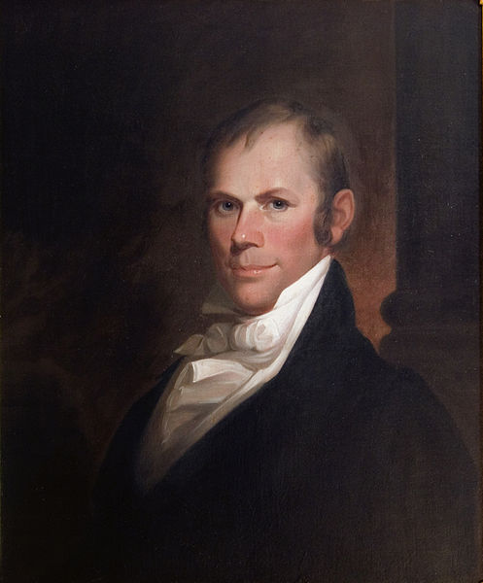
American System
As the North and South developed different economies politicians rallied behind an economic plan to unify the nation.
Speaker of the House, Henry Clay, promoted President James Madison’s plan to unify the nation as the American System
Develop transportation systems and other internal improvements
Establish a protective tariff
Establish a second national bank
The plan would allow an increasingly industrial North to produce manufactured goods that farmers in the South and West could buy
While the South and West would produce most of the grain, meat and cotton needed in the North
By sustaining each other, we could be economically independent from Britain and the rest of Europe

Slide 3
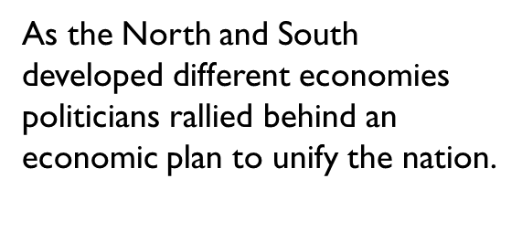
National Road
After the War of 1812, Americans went on a road building frenzy
Private investors, states and the federal government built private roads called turnpikes; charged tolls to offset costs of maintenance
By 1815, New York had chartered 300 companies to build 5,000 miles of gravel roads
By 1818 U.S. government opened the “National Road” connecting the Potomac River at Cumberland Maryland with Wheeling (West) Virginia on the Ohio River
Road was best technology could offer, but fell into poor condition because of heavy traffic

Slide 4
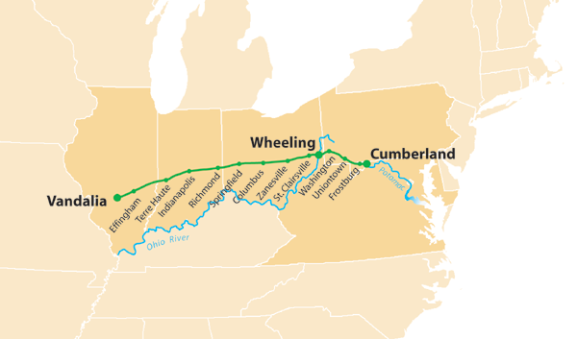

Slide 5
Erie Canal
In 1817 Governor DeWitt Clinton talked the NY state legislature into building a canal linking the Hudson River with Lake Erie
Would open a continuous water route between the Northwest and New York City
Built with the hands, backs and shovels of self-taught engineers and gangs of Irish immigrants, local farm boys and convict labor
Known as “Clinton’s Ditch”; it stretched 364 miles from Albany to Buffalo; Canal was 4 feet deep and 40 feet wide
Required a system of 83 locks and it passed over 18 rivers on stone aqueducts; enabled boats to travel 675 feet up and down from one end to the other
Construction began in 1819 and reached Buffalo by 1825
Clinton in a ceremony poured water from Lake Erie into the Atlantic Ocean when completed

Slide 6
Erie Canal
Once opened, traffic on the canal expanded quickly; western agricultural products moved eastward while manufactured goods and immigrants traveled westward
By replacing rough roads, transportation costs dropped drastically
Biggest impact on western NY: cities of Syracuse, Rochester and Buffalo grew out of farmland; New York City would become the greatest city in the nation
By 1834 9 boats passed through the locks of the canal each minute
NY gained $500,000 a year from tolls; by 1882 it had produced revenues of up to $121 million
More than 40,000 passengers traveled on the new waterway a year; settlers, tourists, salesmen and evangelical ministers
Started a canal boom lasting 20 years; Ohio and Pennsylvania led the nation in canal building
When construction began on Erie Canal there were fewer than 100 miles of canal in the U.S.; by 1840 there were 3,300 miles most of which were in the Northeast and Northwest

Slide 7
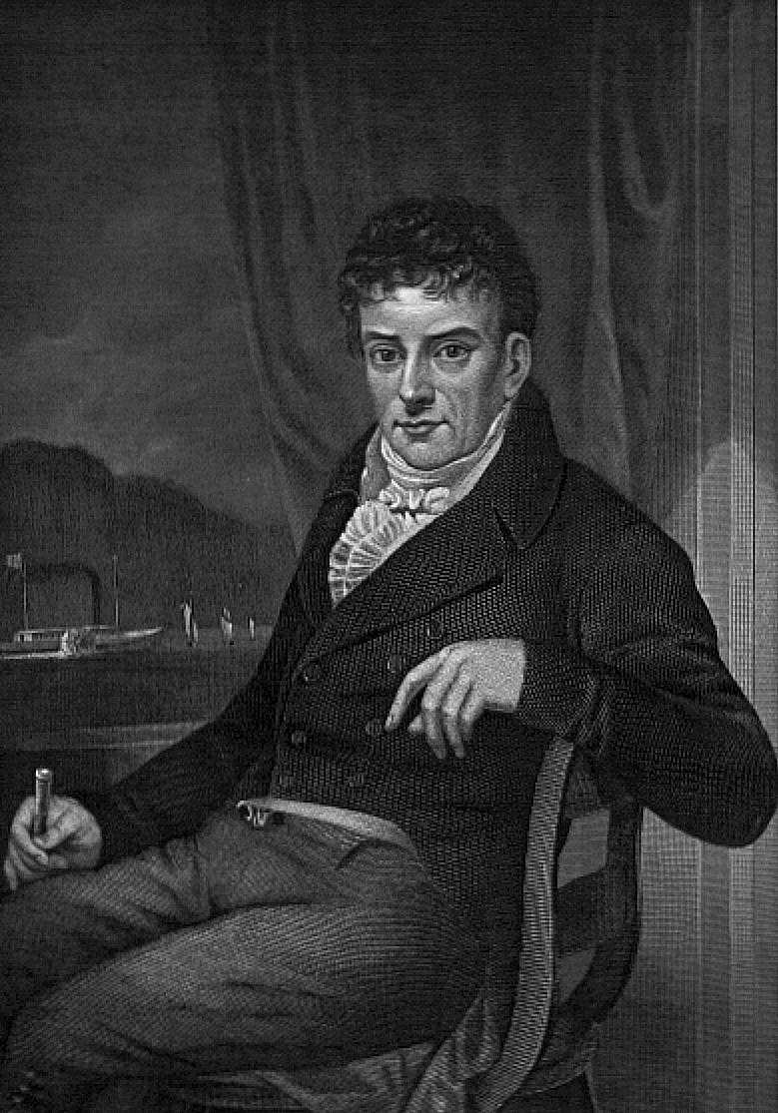
Steamboats
Canals reached only a limited part of the continent; rivers offered faster and cheaper travel; especially the Mississippi, Ohio and Missouri Rivers
But those who wanted to transport goods northward had to push boats against the current; sometimes with poles, sometimes with ropes held by crew that dragged the boats upstream; process took 3 or 4 months
Others sold craft for scrap and walked back home
Robert Fulton had developed steamboats in the Northeast in 1807 beginning with the Clermont; built one for the Mississippi by 1811
War of 1812 had slowed development of the steamboat because steam engines had to be shipped from England
By 1815 production resumed;

Slide 8
Time and Money
Transportation revolution brought reduction in time and money it took to move heavy goods
Turnpikes cut cost of wagon transport in half from 1816-1860 (30 cents per ton/mile to 15 cents)
Erie Canal and Ohio canals reduced distance between East and West and carried goods at 1 cent per ton/mile
Overland route from Cincinnati to New York in 1815 took 52 days minimum; by the 1840s an all water route from Cincinnati to New York City would be 18 days.
In 1817 the journey from New Orleans to Louisville by steamboat took 25 days; by 1819 it took 14 days

Slide 9
Erie Canal Video
Erie Canal
Guided Questions
How did DeWitt Clinton get the Erie Canal built?
Historian Peter Bernstein said that “the Erie Canal was the marvel of its age”. What made it such a marvel?

Slide 10
The American System
STEP 2: A tariff (a tax on imported goods)
Made European goods more expensive
Encouraged Americans to buy cheaper products made in America
Made the country money, used for national improvements
Developments include…
1816- President James Madison proposes a tariff that would tax all imported foreign goods.
The proposed tariff would help the American manufacturing economy become more competitive with the foreign markets, because the imposed tariff would offset the prices of foreign/domestic goods.
The north encouraged the tariff because it would improve the their economy and increase total profits.
The south and west discouraged the tariff because they would have to pay more for the same products.

Slide 11
Step 3: A National Bank
Stabilize/ strengthen the currency and control risky banks
Developments include…
1816- The Second Bank of the United States (BUS) was approved for a 20-year term by the Congress.
The bank charter would establish a national, guaranteed currency, that would improve national and regional trading of goods and services.
The national bank idea had been revived from the presidency of George Washington, and had become vastly popular among all regions of the country.
1816- James Monroe (VA) is elected US President.
Begins a new presidency, “Era of Good Feelings!”

Slide 12
Intro video
Found at:
http://youtube/jJppEhwRsVQ

Slide 13
North Economy: +/-
Northern Economy: Strengths
1. The north had just experienced an Industrial Revolution, and was producing manufactured goods.
2. New methods of transportation that brought goods to and from the manufacturing north.
3. A new, national currency that enabled the north to trade with the south and west.
Northern Economy: Weaknesses
1. Poor soil, low crop production, few livestock.

Slide 14
Southern/Western Economy: +/-
Southern/Western Economy: Strengths
1. Good and rich soil for plantation farming.
2. Increased slavery, increased productivity.
3. Use of the Mississippi River for transportation of goods between the north and south economies.
Southern/Western Economy: Weaknesses
1. Few factories for manufacturing goods.
2. Heavy, intense labor needed to run the plantations smoothly in the south.

Slide 15
Venn Diagram: North v. South
Task: (PUT IN NOTEBOOK)
Compare and contrast the northern and southern economies using a Venn diagram. Use a (+) symbol for a positive comparison, and use a (–) symbol for a negative comparison.
You should include at least three differences and three similarities between the two economies.
Make a concluding statement about the similarities and differences of the two economies.
Share the conclusion with the class or small group.

