Slide 1
American History II Honors
Spring 2020
Heritage High School
Mr. Edwards

Slide 2
Introduction-American History II Honors: Mr. Edwards
Email: dedwards4@wcpss.net
Website: dedwardsushistory.weebly.com
Office Hours:
Thursdays 2:30-3:30 (Room 2522)
Join Remind
2nd Period Enter 81010/Text @84e87ge
4th Period Enter 81010/Text @cbbdf6
Join Google Classroom
2nd Period: wyurjc2
4th Period: qt5vecm

Slide 3
American History II Honors Introduction: Syllabus Course Description
You will examine the roles of people, events, and issues that have impacted the political, social, cultural and economic development of the United States from 1877-the Present
You will be asked to develop historical understanding and skills by using a variety of historical sources of evidence to analyze and evaluate multiple perspectives of the past.
The ultimate goal of this course is to enable you to gain a better understanding of events, issues, and yourself as an American citizen by asking and answering questions, as well as, formulating and supporting your own interpretations of the past.
Primary Essential Question: What does it mean to be an American?

Slide 4
Course Outline
Introduction Unit on the West (1860-1900)
Unit 1: The Gilded Age: Industrialization & Urbanization (1877-1900)
Unit 2: The Progressive Era (1890-1917)
Unit 3: Imperialism & World War I (1890-1919)
Unit 4: The Roaring 20s and the Great Depression: Modernism, Traditionalism & Depression (1920-1941)
Unit 5: World War II: Patriotism, War & Sacrifice (1936-1941)
Unit 6: The Cold War: Anxiety & Fear (1946-1989)
Unit 7: Civil Rights: Justice, Equality, Movement & Protest (1946-1975)
Unit 8: The Modern Era: Conservatism, Terrorism & Hope (1976-Present)

Slide 5
Syllabus : (See handout)
Class Expectations/Procedures
2nd Period-Science Lab Agreement
Grades
Classwork
Homework
Quizzes
Tests
Make Up Policy
Academic Integrity

Slide 6
Honors Opt Out
2-week window
Letters will go home afterwards
Questions?

Slide 7
History
History-”Change over time”
Historians are in the business of using historical evidence and skills to study “change over time”
Historical Inquiry
Historical Perspective
Historical Analysis
Detecting Bias
Determining Relevance
Taking Notes*

Slide 8
Historical Inquiry
The research or investigation of past events
Should begin with a historical question. Historical questions typically address “how” and/or “why” past decisions were made, past actions were taken, or past events occurred.
Causation
Change or Continuity
Comparison
Contextualization
requires the acquisition and analysis of historical data and documents beyond the classroom textbook.
allows an analysis of preexisting interpretations, to raise new questions about an historical event

Slide 9
Historical Perspective
judging the past in consideration of the historical context in which the events unfolded and not solely in terms of personal and/or contemporary norms and values.
Helps develop historical empathy
How then did the social, political, cultural, or economic world of certain individuals and groups possibly influence their motives and intentions, their values and ideas, their hopes, doubts, fears, strengths, and weaknesses?

Slide 10
Historical Analysis
Involves a variety of historical documents and artifacts (primary and secondary sources) that present different voices and interpretations or perspectives on the past.
The study of history is subject to an individual’s interpretation of past events, issues, and problems.
There is usually no one right answer, one essential fact, or one authoritative interpretation that can be used to explain the past.
Historians may differ on the facts they incorporate in the development of their narratives and disagree on how those facts are to be interpreted.
Written history is a “dialogue” among historians, not only about what happened but about the historical interpretation of why and how events unfolded.
“dialogue”

Slide 11
Detecting Bias
Students of history should differentiate between historical facts and historical interpretations but acknowledge that the two have a connection
Facts that historians report are selected and reflect the historian's judgment of what is most significant about the past.
That judgement could be biased.
How can historical evidence be biased?

Slide 12
Finding Relevance
Students of history should use specific criteria to judge the relevance of the past to contemporary events
Historical issues are frequently value-laden and subsequently create opportunities to consider the moral convictions that possibly contributed to those actions taken by individuals and groups in the past.
The past inevitably has a degree of relevance to one’s own times
How can the past have relevance to the present?

Slide 13
Historical Analysis: Analyzing a Primary Source
HIPP

Slide 14
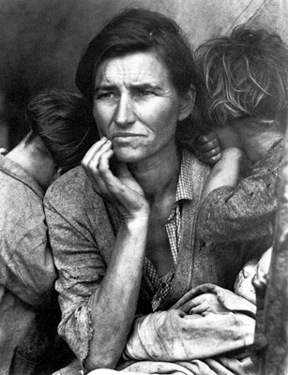
HIPP Analysis
Notes:
Migrant Mother. Nipono, California 1936.

Slide 15
Historical Context: “Migrant Mother”
The photograph that has become known as "Migrant Mother" is one of a series of photographs that Dorothea Lange made of Florence Owens Thompson and her children in February or March of 1936 in Nipomo, California.
These photographs would have been taken at the height of the Great Depression.
Lange was concluding a month's trip photographing migratory farm labor around the state for what was then the Resettlement Administration.
This government agency would later become the Farm Security Administration, a program that was part of Franklin Roosevelt’s New Deal.

Slide 16
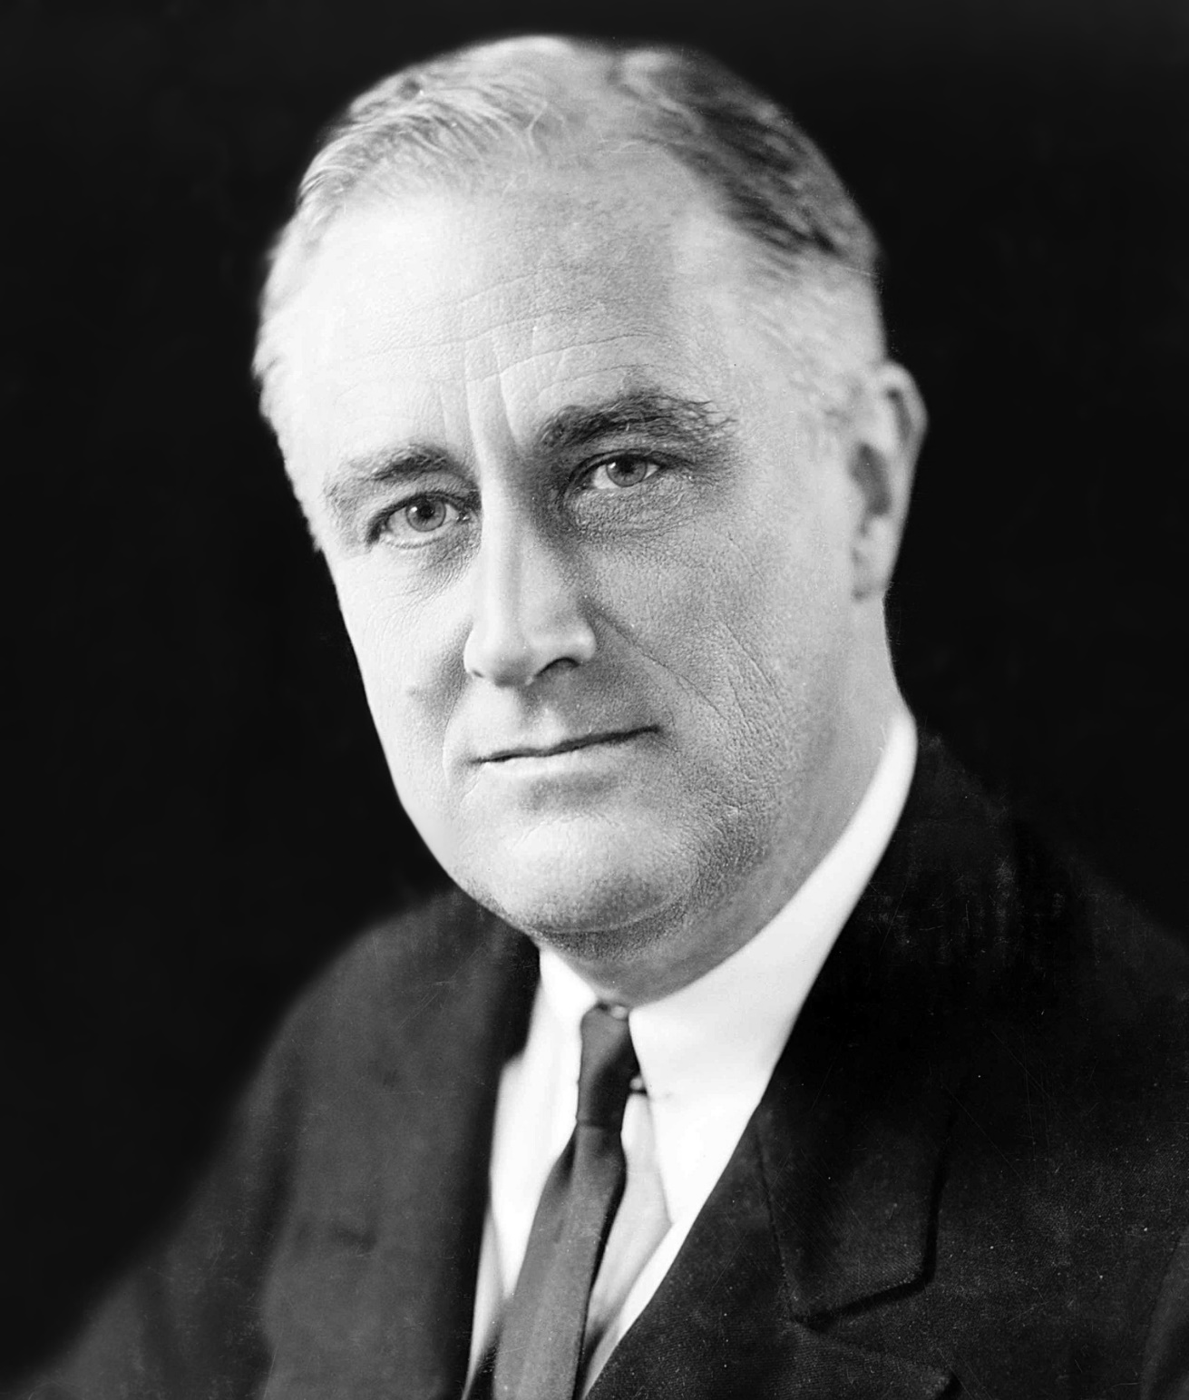
Franklin Roosevelt (D) 1933-1945

Slide 17
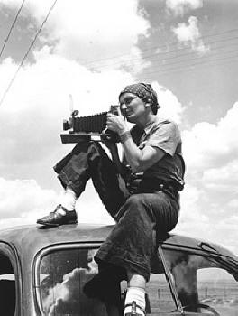

Slide 18
Interview: Dorothea Lange
“I saw and approached the hungry and desperate mother, as if drawn by a magnet. I do not remember how I explained my presence or my camera to her, but I do remember she asked me no questions. I made five exposures, working closer and closer from the same direction. I did not ask her name or her history. She told me her age, that she was thirty-two. She said that they had been living on frozen vegetables from the surrounding fields, and birds that the children killed. She had just sold the tires from her car to buy food. There she sat in that lean- to tent with her children huddled around her, and seemed to know that my pictures might help her, and so she helped me. There was a sort of equality about it.” (From: Popular Photography, Feb. 1960).

Slide 19
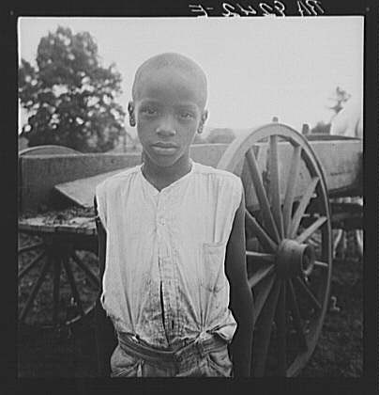
Notes:
Child in Mississippi Delta

Slide 20
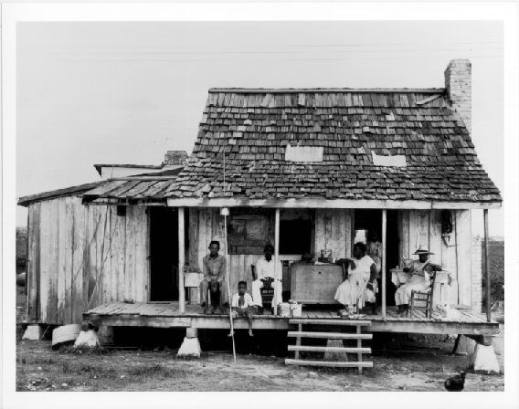

Slide 21
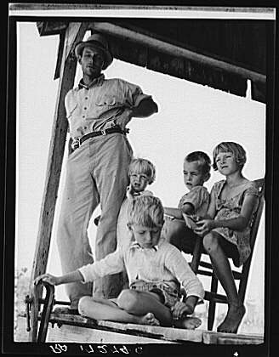
Notes:
Cotton sharecropper family near Cleveland, Ohio

Slide 22
Possible Historical Question
How did the Great Depression impact American families between 1929 and 1940?
What type of evidence did you just analyze to help answer that question?
What other sources/evidence can you analyze to better answer the essential question?

Slide 23
Concept Based Theme
An organizing idea or concept; a mental construct that is timeless, universal, abstract, represented by 1-2 words, examples may be factual and share common attributes

Slide 24
Concept Based Themes: American History
Exploration
Diversity
Migration
Conflict
Compromise
Expansion
Liberty
Equality
Power
Progress
Reform
Identity
Which theme(s) in American History do you best identify with? How? Why?

Slide 25
Homework: Historical Context Activity
Define who you are.
Within your identification you need to make historical connections as you tell your story (narrative). Use specific factual information (SFI) in making the connections to the following:
Who?
What?
Where?
When?
These connections represent historical context
Extend your connection to a theme in American History.
Handwritten
Minimum of 1 page

