Slide 1
Bell Ringer
Define using a rubric for identifications: The Enlightenment
This is a timed activity-10 minutes

Slide 2
American Colonial Society in the 18th Century
The Enlightenment

Slide 3
Key Concept 2.2 The British colonies participated in political, social, cultural, and economic exchanges with Great Britain that encouraged both stronger bonds with Britain and resistance to Britain’s control.
I. Transatlantic commercial, religious, philosophical, and political exchanges led residents of the British colonies to evolve in their political and cultural attitudes as they became increasingly tied to Britain and one another.
D. Colonists’ resistance to imperial control drew on local experiences of self-government, evolving ideas of liberty, the political thought of the Enlightenment, greater religious independence and diversity, and an ideology critical of perceived corruption in the imperial system.

Slide 4
Essential Question:
To what extent had the American colonies developed self-rule and a democratic society by 1754?

Slide 5
What was the Enlightenment?
The Enlightenment or “Age of Reason” was a cultural movement of intellectuals beginning in the late 17th and 18th century Europe emphasizing reason and individualism rather than tradition.
Its purpose was to reform society by challenging ideas grounded in tradition and faith, and advance knowledge through the scientific method. (belief that all problems could be solved by human reason)
It was characterized by dramatic revolutions in science, philosophy, society and politics

Slide 6
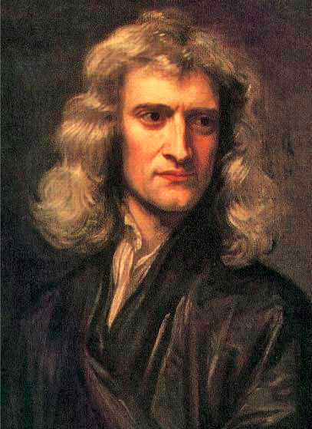
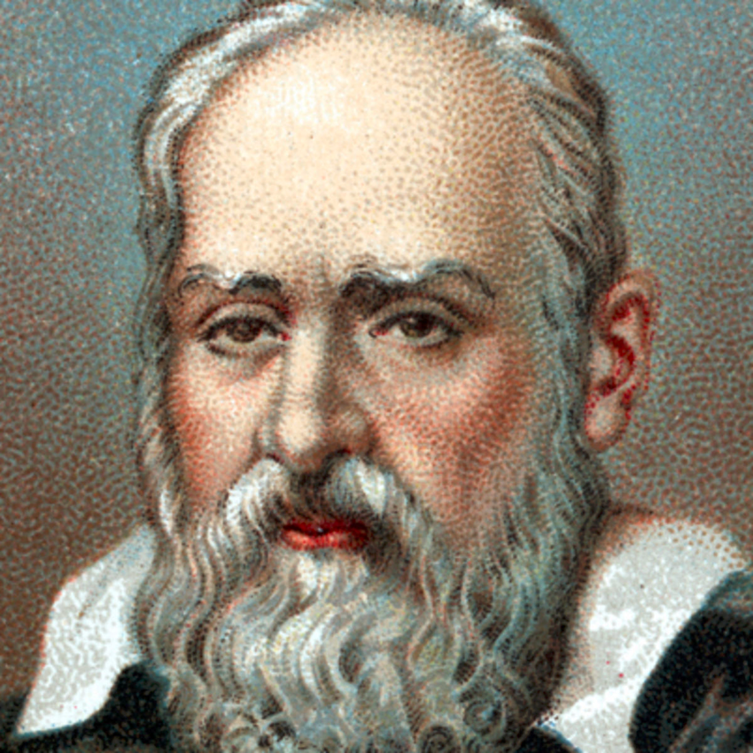
Enlightened Scientists
Sir Isaac Newton (1642-1727) English scientist formulated the laws of motion and universal gravitation that dominated scientists' view of the physical universe for the next three centuries.
He also demonstrated that the motion of objects on the Earth and that of celestial bodies could be described by the same principles
Galileo (1564-1642) Italian astronomer and first to believe in heliocentricism--the astronomical model in which the Earth and planets revolve around a relatively stationary Sun at the center of the Solar System.

Slide 7
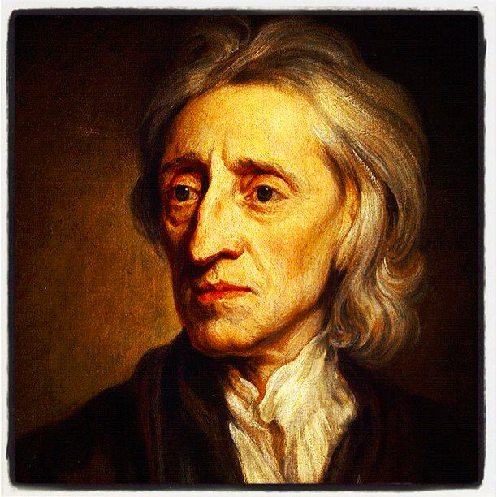
Enlightened Politicians
John Locke--English philosopher (1632-1704)
argued that knowledge was gained through accumulated experience (human reason) rather than by accessing some sort of outside truth (God)
Believed that sovereignty resides in the people
Believed that people have certain natural rights - rights that belong to every human being from birth
challenged the idea of divine right – which stated that monarchs got their authority to rule from God
His reasoning of a social contract between the government and its people led to the conclusion: if the government doesn’t protect the rights of the people, then the people have a right to overthrow the government

Slide 8
Divine Right vs. Natural Rights
Divine Right
Natural Right
Where does the right to govern come from? | From God to the Ruler | From the People
Where do people’s rights come from? | From the Ruler | From God to the People
What happens if a government violates people’s rights? | People must obey ruler | People can change their govt.

Slide 9
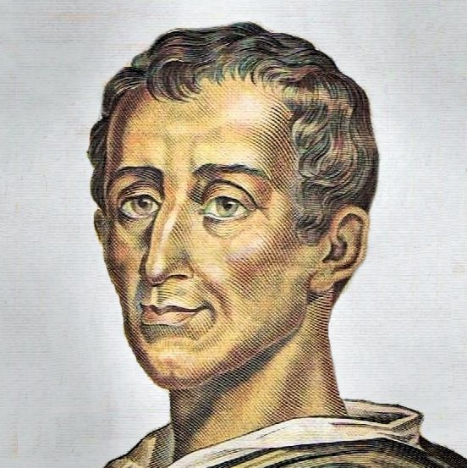
Enlightened Politicians
Montesquieu--French thinker (1689-1755)
argued that powers of the government should be clearly defined and limited
favored separation of powers - division of the power of government into separate branches (Legislative, Judicial, Executive) as a means to limit the powers of government
Part of the “high Enlightenment” in which there was a notion that everything in the universe could be rationally demystified and cataloged

Slide 10
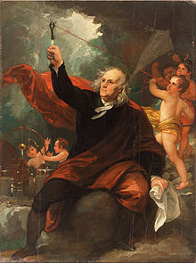
Benjamin Franklin
Enlightened Thinker
1718 - 1723 Apprenticed as a printer to his brother James Franklin
1727 Founded the Junta, a debating club, Philadelphia, Pa. (would become American Philosophical Society)
1729 Purchased Pennsylvania Gazette
1731 Established the Library Company of Philadelphia, Pa
1732 - 1758 Published Poor Richard and Poor Richard Improved, commonly known as Poor Richard's Almanack

Slide 11
The colonial press
1. Manual printing presses ran off pamphlets, leaflets and journals.
Effective for airing social grievances and building opposition to the British.
2. Zenger Case (1735)
a. The case paved the way towards freedom of expression.
b. John Peter Zenger's newspaper had criticized the corrupt royal governor.
c. He was charged with seditious libel and brought to trial.
d. He argued that he had printed the truth; the royal chief justice ruled that printing was enough to convict, regardless of the truth.
e. The jury ruled in favor of Zenger.
f. Newspaper editors thus received some freedom (not as much as post-1776).

Slide 12
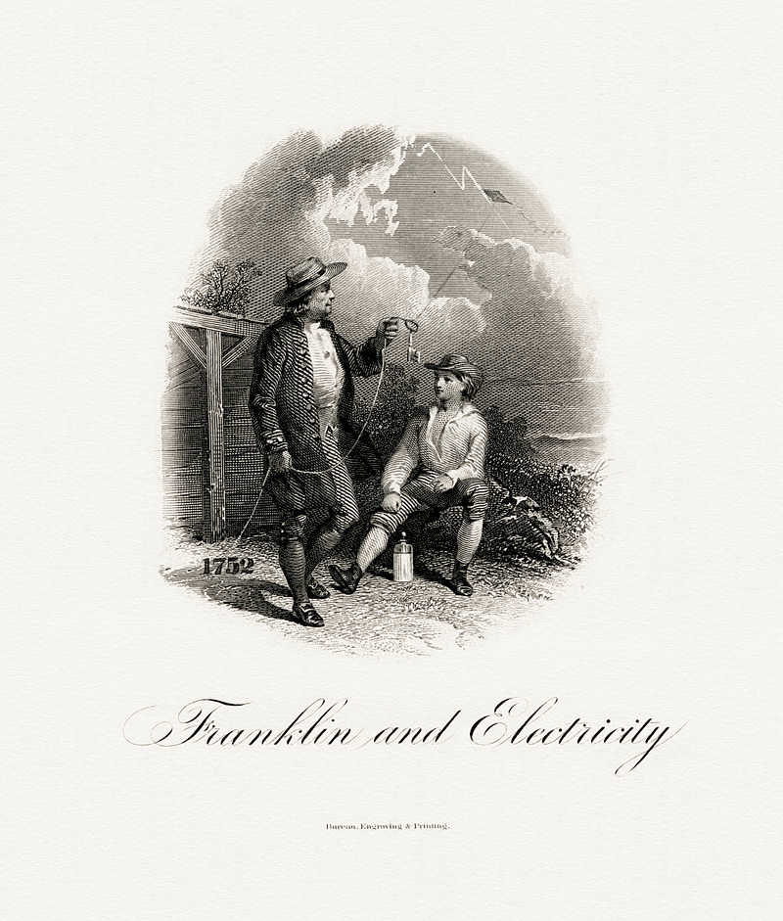
Benjamin Franklin
Enlightened Thinker
1740 Invented the Pennsylvania fireplace (Franklin stove)
1743 Proposed formation of the American Philosophical Society
1751 Founded with others, the Academy for Education of Youth -now University of Pennsylvania, Philadelphia, Pa.
1751 Founded Philadelphia City Hospital, Philadelphia, Pa
1751 Published Experiments and Observations on Electricity
1751 - 1764 Represented Philadelphia at the Pennsylvania Assembly
1754 Represented Pennsylvania at the Albany Congress

Slide 13
Ben Franklin’s 13 Virtues as stated in his Autobiography
Temperance—Eat not to dullness; drink not to elevation.
Silence—Speak not but what may benefit others or yourself; avoid trifling conversation.
Order—Let all your things have their places; let each part of your business have its time.
Resolution—Resolve to perform what you ought; perform without fail what you resolve
Frugality—Make no expense but to do good to others or yourself; waste nothing
Industry—Lose no time; be always employed in something useful; cut off all unnecessary actions.
Sincerity—Use no hurtful deceit; think innocently and justly, and, if you speak, speak accordingly.
Justice-Wrong none by doing injuries, or omitting the benefits that are your duty.
Moderation-Avoid extremes; forbear resenting injuries so much as you think they deserve.
Cleanliness-Tolerate no uncleanliness in the body, cloaths, or habitation.
Tranquility-Be not Disturbed at trifles, or at accidents common or unavoidable.
Chastity—Rarely use venery but for health or offspring, never to dullness, weakness, or the injury of your own or another’s peace or reputation.
Humility—Imitate Jesus and Socrates

Slide 14
Deism
Religious or philosophical branch of the Enlightenment
1. Naturalistic view of God
Premise: God created the universe and then stepped back—”Clockmaker”; universe ran like a clock—the "Ghost in the Machine“
2. Believed in reason over revelation
3. Deists largely rejected traditional Christianity and the divinity of Jesus
4. Influenced Jefferson, Franklin, Washington & Paine
5. Not a wide-scale movement; popular among certain groups of intellectuals

Slide 15
Group Essential Question Poster
As a group divide and assign the following responsibilities:
Read and analyze the following documents with the HIPP analysis tool.
Document A-John Locke, Second Treatise of Government
Document B-John Peter Zenger on “Suspicion of Arbitrary Power”
Document C-Benjamin Franklin Autobiography, “on the Junto”
Use your understanding of the Enlightenment based upon your reading, these documents and the Power Point presentation to answer the following question: To what extent had the American colonies developed self-rule and a democratic society by 1754?
Use your understanding of the Colonial Era to think of other events, topics, people, etc. that would support an answer to this question. Make a list of this specific factual information making a brief statement as to how and why the SFI answers the question.
Place all information on a poster to be displayed using the paper provided.

Slide 16
Bibliography
College Board, AP United States History Course and Exam Description (Including the Curriculum Framework), 2014: History, New York: College Board, 2014
Bailyn, Bernard, The Origins of American Politics, New York: Vintage Books, 1968 _____________, The Ideological Origins of the American Revolution, Cambridge, Massachusetts: Belknep, 1967
Brinkley, Alan, Williams, T. Harry, and Current, Richard N., American History, 14th Edition, New York: McGraw-Hill, 2012
Cook, Don, The Long Fuse: How England Lost the American Colonies, 1760-1785, New York: Atlantic Monthly Press 1995
Foner, Eric & Garraty, John A. editors: The Reader’s Companion to American History, Boston: Houghton Mifflin Company, 1991
Hofstadter, Richard, America at 1750: A Social Portrait, New York: Vintage Books, 1971
Kennedy, David M., Cohen, Lizabeth, Bailey, Thomas A., The American Pageant (AP Edition), 13th edition, Boston: Houghton Mifflin 2006
Murrin, John, et al., Liberty Equality and Power: A History of the American People, Ft. Worth: Harcourt Brace 1999
Nash, Gary : American Odyssey, Lake Forest, Illinois: Glencoe, 1992 Wikipedia Commons, maps of the Triangular Trade

