Slide 1
African Americans in the War
Emancipation and Enlistment

Slide 2
Bell Ringer
Take out your Battles Summary Chart and Civil War map from yesterday
Be prepared to share out your research on the following battles:
First Bull Run
Shiloh
Antietam
Use your battles summary chart for the battle of Antietam as we watch parts of Episode 3 of Ken Burns’ The Civil War
As you watch the video of the battle, add information to your battles summary chart. Be prepared to share out the information that you have on the battle.

Slide 3
Emancipation Proclamation
What was the Emancipation Proclamation?
Why did Lincoln push for its adoption after the Battle of Antietam?

Slide 4
Lincoln and Slavery
Lincoln allowed slavery in the border states in order to keep them in the Union
Slavery was a continued debate in Congress
Radicals favored abolitionism
Conservatives favored gradualism
Lincoln was cautious of emancipation
Momentum in Congress for emancipation
Confiscation Act of 1861
Abolished slavery in D.C and in Western territories
Confiscation Act of 1862
Lincoln was looking to declare complete emancipation in the Confederate States – needed a big Union victory

Slide 5
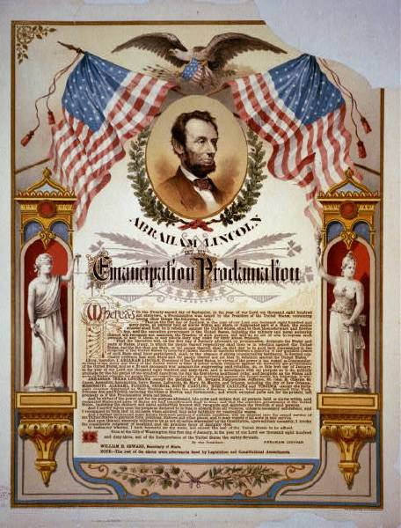
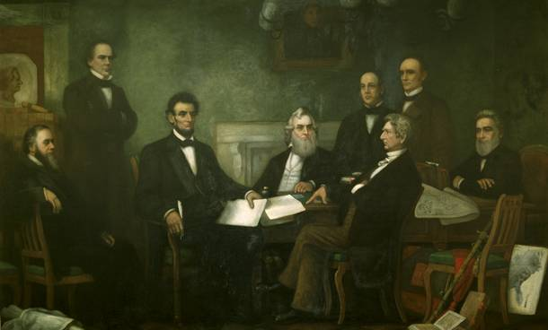
The Emancipation Proclamation

Slide 6
The Emancipation Proclamation
Freed slaves located in states that were still in rebellion against the United States by January 1, 1863
It did not free slaves in the border states. Why?
Lincoln claimed that he could issue the proclamation as Commander in Chief of the Union’s armed forces. Why?

Slide 7
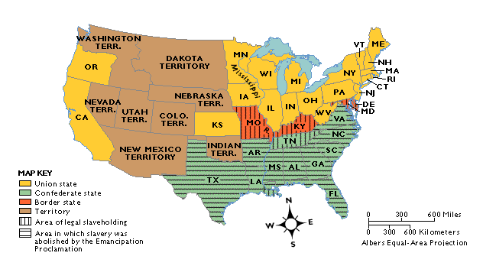
Emancipation in 1863

Slide 8
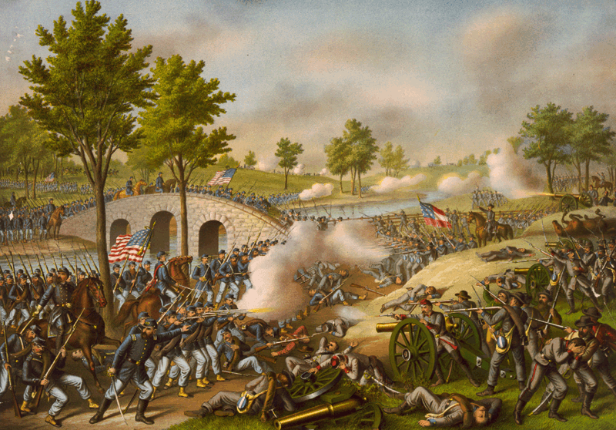
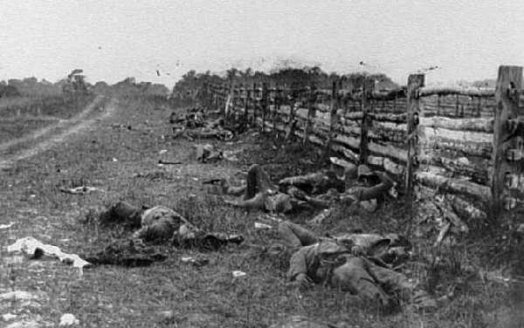
Battle of Antietam “The Bloodiest Single Day of the War”
September 17, 1862
23,000 casualties

Slide 9
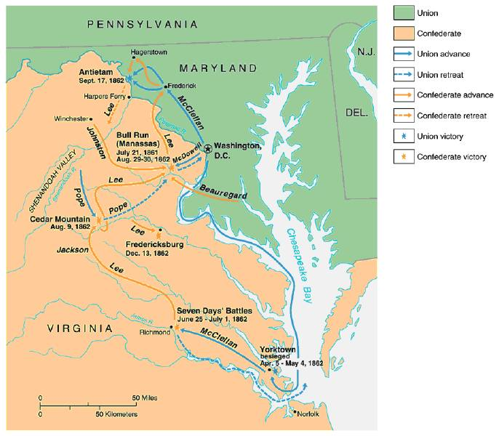

Slide 10
Why issue the Emancipation Proclamation after the battle of Antietam?
Antietam was a union victory. Why was that important?
Both Great Britain and France would choose to back the Union after the victory. They also had outlawed slavery

Slide 11
Effects of Emancipation
Antislavery beliefs grew strong in the North
North fighting for both the preservation of Union and to end slavery
About 186,000 emancipated blacks joined free blacks in the North to serve as soldiers, sailors and laborers for the Union
Other free African Americans served as spies, and organized their own military units to fight against the South and millions more were refugees
Great Britain and France would support the Union instead of the Confederacy

Slide 12
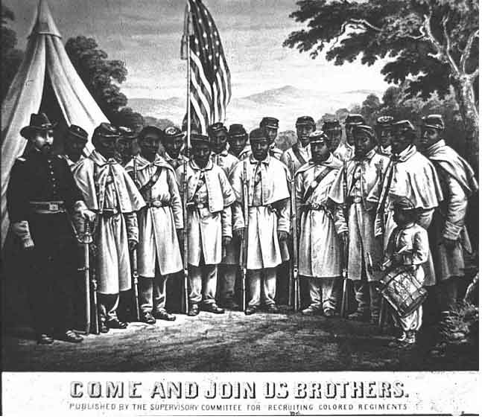
African American Recruiting Poster

Slide 13
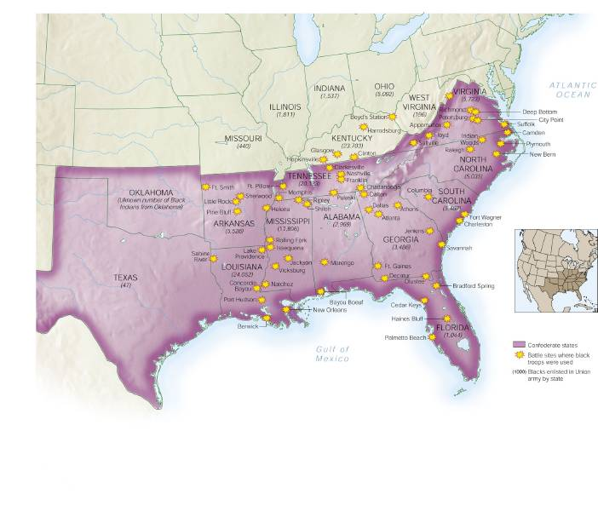
African Americans in Civil War Battles

Slide 14
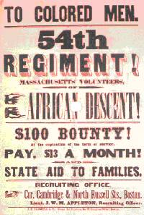
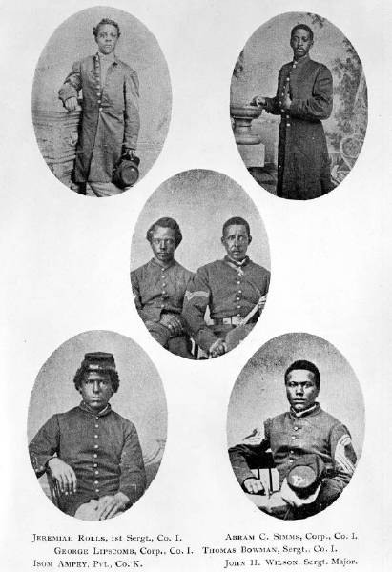
Other Effects
54th Massachusetts and other units changed perspectives on African Americans
70,000 African Americans died (higher mortality rate than whites)
Led to 13th Amendment

