Slide 1
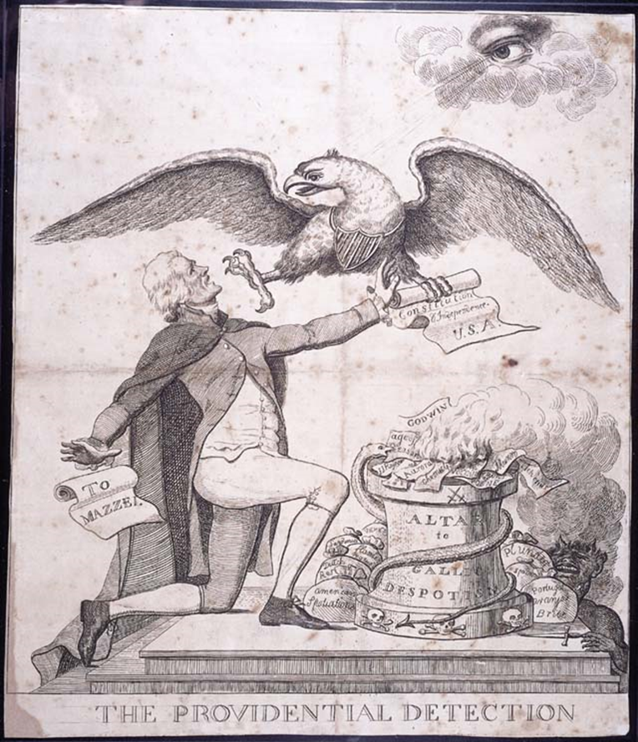

Slide 2
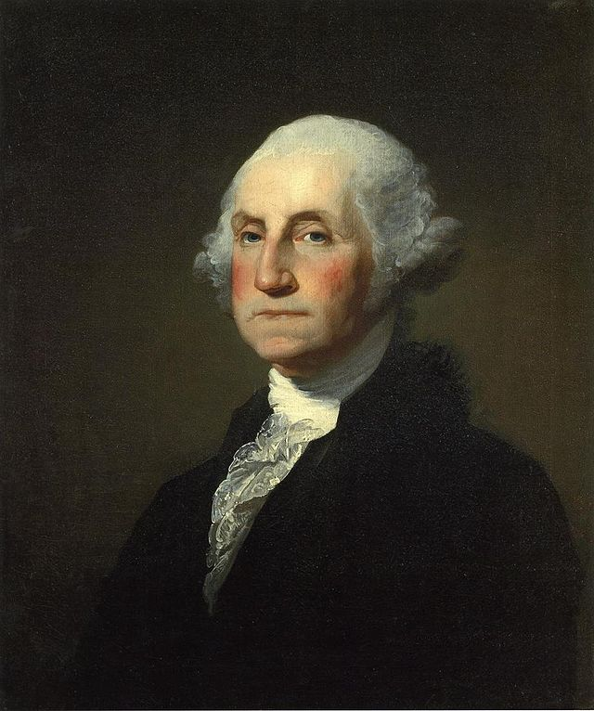
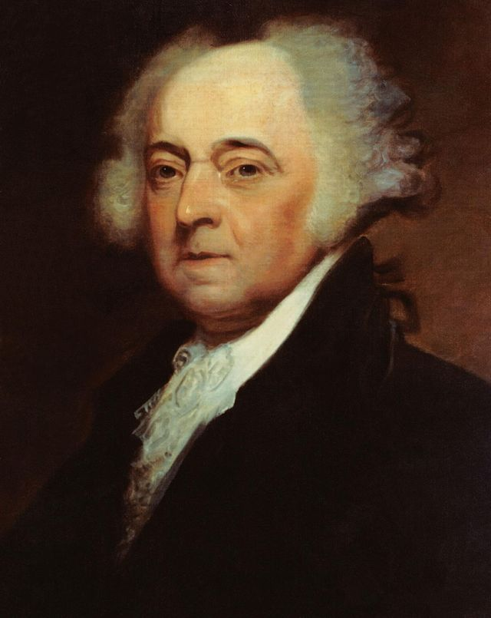
Launching a New Nation

Slide 3
Election of 1796
1796, Washington announces he will not seek a third term as President
Thomas Jefferson ran as Republican candidate
John Adams ran as Federalist candidate
Back then, Pres. and VP were not elected together on the same ticket – instead candidate with most votes became Pres. and 2nd place candidate became VP
Adams became Pres. (Federalist), Jefferson became VP (Republican) – led to serious tension over next 4 years

Slide 4
John Adams Wins the Election of 1796
Narrow victory for Adams over Jefferson – 71 to 68
The election demonstrates sectionalism
John Adams instantly had problems staying neutral

Slide 5
Washington’s Farewell Address
George Washington’s Farewell Address
Praised benefits of federal govt.
Stressed importance of morality
Warned against national debt and deems taxes necessary
Warned against political parties
Warned against involvement in foreign affairs and creating alliances
Warned against creating a military that is too over-powering
Washington’s accomplishments
U.S. had a functioning govt.
Economy was improving
Had avoided war
British had been forced to leave forts in NW Territory

Slide 6
John Adams (F) (1797-1801)
Federalist
XYZ Affair
Quasi War
Alien and Sedition Acts
Virginia and Kentucky Resolutions

Slide 7
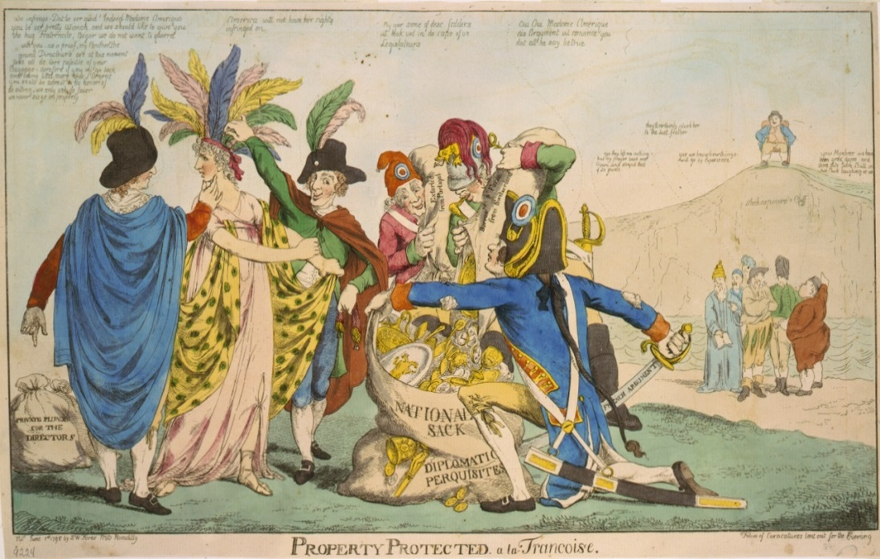
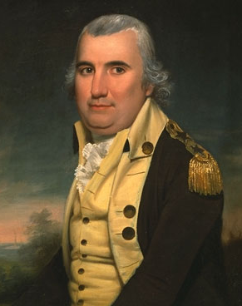
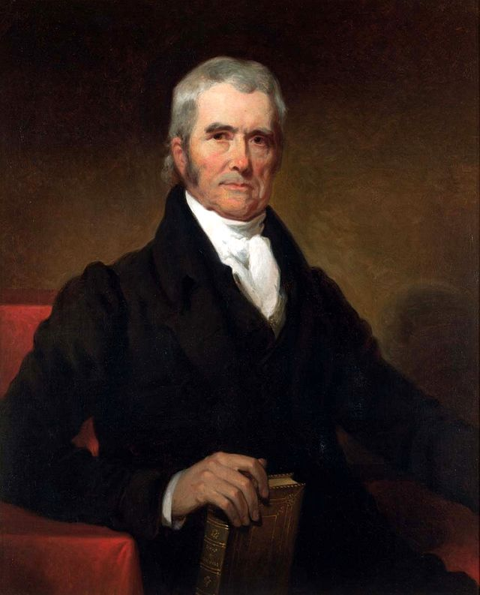
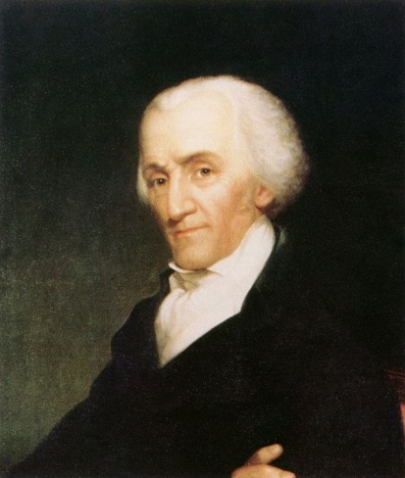
XYZ Affair
French attacks on American ships began because of their irritation with the Jay Treaty
Adams sent Charles Pinckney, John Marshall and Elbridge Gerry to negotiate a settlement with French
French foreign minister Talleyrand sent agents (X, Y, Z) to demand a bribe from the American delegation in order to negotiate
X, Y, Z Affair – angered Adams and Americans; “millions for defense, but not one cent for tribute!”
US cuts trade with France and battled France’s Navy for 2 years
Led to creation of American Navy and the tripling in size of U.S. Army
Quasi-War (Undeclared War) with France divides the nation (Federalists for the war, Republicans against)

Slide 8
Alien and Sedition Act
The Federalists passed the controversial Alien and Sedition Act to silence critics and D-Rs
Alien Act:
Made it harder for people to immigrate – raised resident requirements from 5 to 14 years (most Aliens voted for the Republican party)
Allowed executive branch to deport any aliens that might be a threat to the nation
Sedition Act:
Made it a crime for citizens to publicly discredit the federal government
Was initiated to limit free speech of publications that spoke out against Federalist (many Republican editors arrested and fined)

Slide 9
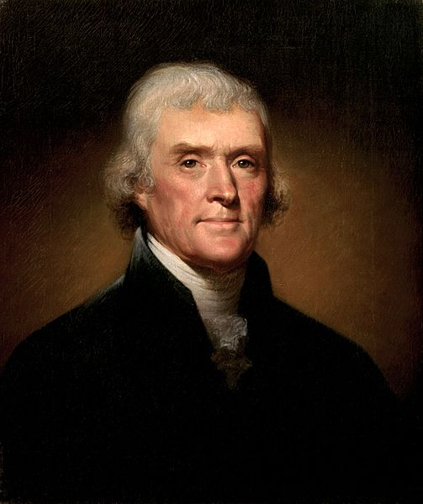
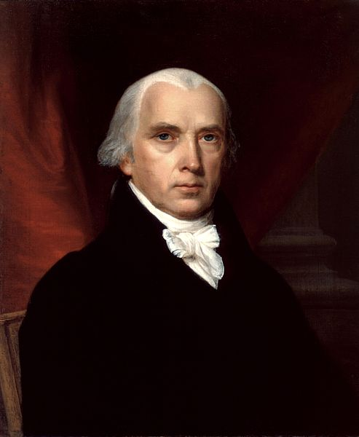
Response to the A&S Acts
Virginia and Kentucky Resolutions 1798-1799
Jefferson (Kentucky Resolution) and Madison (VA Resolution) wrote documents declaring the Alien and Sedition Acts unconstitutional
Argued that acts violated first amendment rights to freedom of speech and the press
They claimed that the states had the power to nullify (declare void) federal laws that were unconstitutional
These resolutions don’t win wide support, but it does elevate the debate to a national level
Violent arguments broke out on the House of Representation floor

Slide 10
Election of 1800
Thomas Jefferson-Republican
John Adams-Federalist

Slide 11
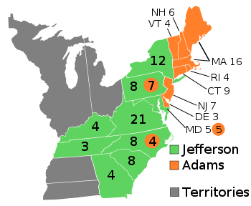
Election of 1800
Democratic-Republicans were well organized at the state and local levels
Federalists were disorganized, and suffered a split between their two major leaders, President Adams and Alexander Hamilton.

Slide 12
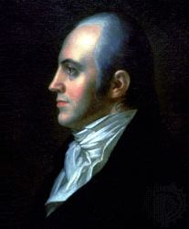
Election of 1800
The election exposed one of the flaws in the original Constitution.
Members of the Electoral College were authorized by the original Constitution to vote for two names for President.
The Democratic-Republicans had planned for one of the electors to not cast his second vote for Aaron Burr, which would have led to Jefferson receiving one electoral vote more than Burr.

Slide 13
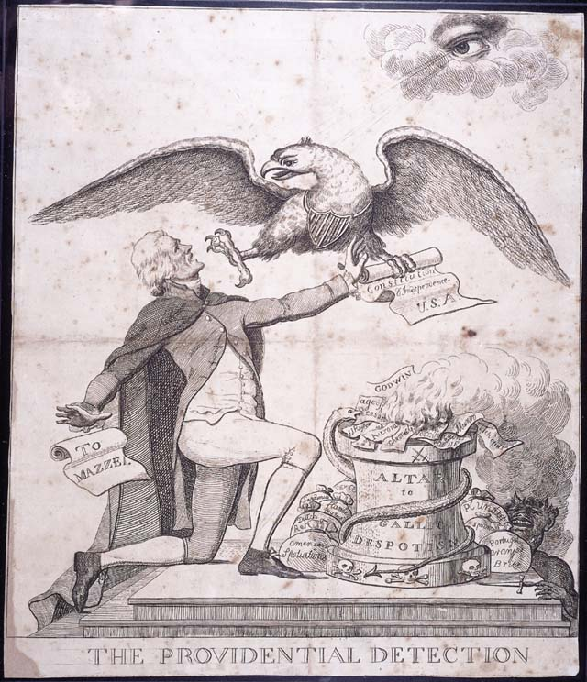
Election of 1800
Each elector who voted for Jefferson also voted for Burr, resulting in a tied electoral vote.
The election was then put into the hands of the House of Representatives, which, after 35 votes was tied.
Alexander Hamilton convinced New York delegates to break the tie on the 36th ballot
To rectify the flaw in the original presidential election mechanism, the Twelfth Amendment ratified in 1804, was added to the United States Constitution, that electors make a choice between their selections for president and vice-president.

Slide 14
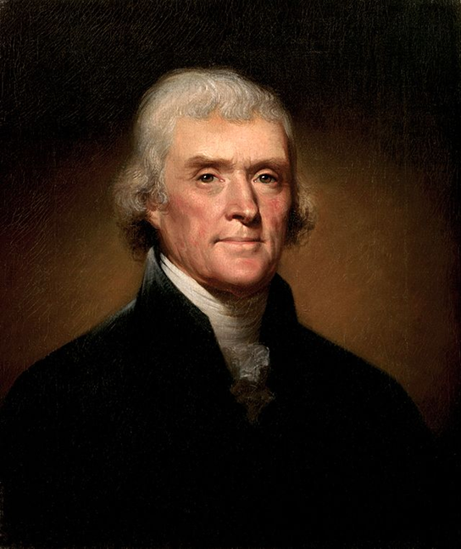
Inauguration Speech
Why would Jefferson’s victory against Adams in 1800 be considered “revolutionary”?
What of the inaugural speech addresses this “revolution”?

Slide 15
President Thomas Jefferson
Republican “Revolution”
Marbury v. Madison
Louisiana Purchase
Barbary Wars
Embargo Act of 1807

