Slide 1
The Roaring Twenties
The Jazz Age
Notes:
A desire for normalcy after World War I and fear of communism and “foreigners” led to postwar isolationism in the 1920s.
Consumer goods fueled the business boom of the 1920s as the standard of living rose dramatically.
As the prosperity of the 1920s ended, severe economic problems caused the Great Depression of the 1930s.
American women pursued careers and assumed different social roles during the 1920s.
African-Americans challenged white-dominated society through a variety of methods during the 1920s and 1930s.
The New Deal led to a large scale expansion of the federal government’s role in regulating the economy.

Slide 2
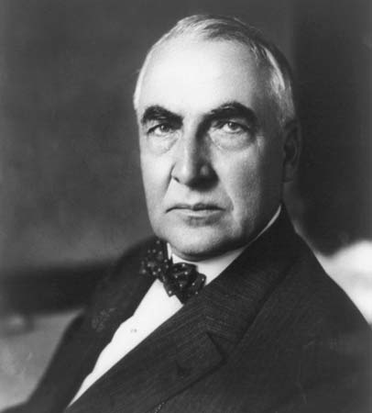
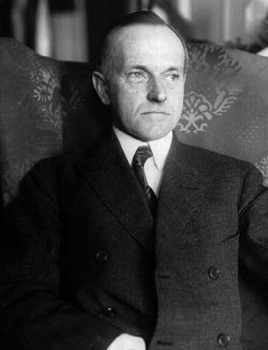
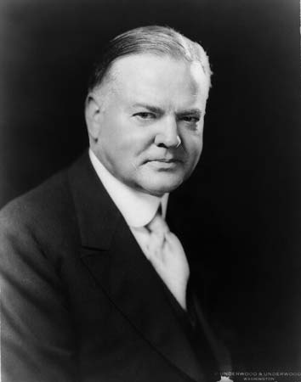
Presidents of the 1920s
Calvin Coolidge
(R) (1923-1929)
Herbert Hoover (R) (1929-1933)
Warren G. Harding (R) (1921-1923)
American presidents during the 1920s were Republican and supportive of big business and generally unsupportive of labor and government regulation of the economy.

Slide 3
Unit 5 Understanding
Many significant social and technological changes posed challenges to American traditions and facilitated cultural change in the 1920s and 30s.

Slide 4
The Roaring Twenties (1920-1929)
Modernism
Traditionalism
Technology/
Industrialization
Consumerism
Urbanization
Individualism/Cultural Expression
Jazz Age
Nativism
Racism
Fundamentalism/ Prohibition
Isolationism
Political Conservatism

Slide 5
Modernism
The horrors of World War I destroyed the belief that Western civilization was actually progressing. The war’s destruction produced a postwar disillusionment among young intellectuals. Such disillusionment would challenge old values.
Modernist thought arose out of the recognition that Western civilization had begun an era of widespread change.
New technologies, new modes of transportation and communication, and new scientific discoveries such as quantum physics and relativity theory combined to alter perceptions of reality and generate new forms of artistic expression.
A new “modernist” mood and movement emerged among artists, writers, and intellectuals.
At the same time that the war accelerated the notion of modernism, it also stimulated political and social radicalism.
Notes:
Harlem Renaissance, Lost Generation of American writers

Slide 6
Traditionalism
The postwar wave of labor strikes, bombings, the rise in Communist membership and race riots convinced many that America had entered a frightening new era of too much diversity and change.
Defenders of tradition and the defensive mood of the 1920s fed on a growing tendency to connect American nationalism with nativism and Anglo-Saxon racism.

Slide 7
Nativism
In the early 1920s, over half of the white men and a third of the white women working in manufacturing industries were foreign born, most of them from central or eastern Europe.
Since socialism and anarchism were popular in these regions, many such immigrant workers were deemed “suspicious” in the eyes of old stock American workers

Slide 8
Nativism
During World War I immigration stopped; afterwards immigration increased greatly
Nativists warned that these immigrants would threaten the American way of life
As fears increased, Congress passed the Emergency Immigration Act of 1921, which restricted new arrivals each year to 3 percent of the foreign born of any nationality as shown in the 1910 census.
A new quota law in 1924 reduced the number to 2 percent based on the 1890 census
purpose : to tilt the balance in favor of immigrants from northern and western Europe, who were assigned about 85 percent of the total.
Notes:
so that an ironic consequence was a great increase in the Hispanic Catholic population of the United States. People of Latin American descent (chiefly Mexican, Puerto Ricans, and Cubans) became the fastest-growing ethnic minority in the country.

Slide 9
Anglo-Saxon Racism
Nativist tradition also took on a new form in that of a revised Ku Klux Klan.
The new Klan was devoted to “100 percent Americanism” and restricted its membership to native-born white Protestants.
The Klan was determined to protect its vision of American life from not only African-Americans, but also from Roman Catholics, Jews, and immigrants
Notes:
In going nativist, the Klan was now national and no longer restricted to the South. Its appeal reached areas such as Oregon and Maine. It thrived in small towns and cities in the North, and especially in the Midwest. It flourished outside the south among the urban social mainstream—attracting clergymen, engineers, accountants, managers, small businessmen, and store owners. And it was preoccupied with the defense of white “native” women and Christian morals.
The Klan was a reaction to shifting moral standards, the declining influence of the churches, and the broadmindedness of city dwellers and college students. In the Southwest, it became more than anything, a moral crusade—“It is going to drive the bootleggers forever out of this land”, declared a Texan. “It is going to bring clean moving pictures…clean literature…break up roadside parking…enforce the laws…protect homes.”

Slide 10
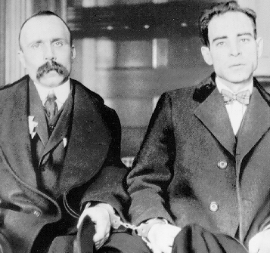
Nicolo Sacco and Bartolomeo Vanzetti “A good shoemaker and a poor fish peddler”

Slide 11
Nicolo Sacco and Bartolomeo Vanzetti
A year after their arrest—the jury deliberated for 5 hours before convicting both men of robbery and murder
All evidence circumstantial
Quick decision for a trial that had lasted 7 weeks; that heard 160 witnesses and gained international attention
August 22, 1927, Sacco and Vanzetti were electrocuted

Slide 12
Nicolo Sacco and Bartolomeo Vanzetti
Legal system failed
All evidence pointed to a professional job; neither man had a past criminal record
Irregular procedures by prosecutor’s office: during the first 2 days of questioning, neither suspect was told why they were arrested; questioning about political beliefs, not crime
Eyewitnesses could not identify Sacco and Vanzetti in a police lineup. Police had forced both men to pose with guns in their hands
Their fingerprints did not match those at the crime scene

Slide 13
Nicolo Sacco and Bartolomeo Vanzetti
Legal system failed
Italians who could back up Sacco and Vanzetti's alibis—Sacco claimed to be in New York applying for a visa, while Vanzetti swore he was delivering eels to his customers—were considered to be too sympathetic to their fellow countrymen and barred from testifying.
Tough sentence despite no past record
Ballistics experts said the bullet that killed the paymaster did not come from Sacco’s Colt pistol

Slide 14
Nicolo Sacco and Bartolomeo Vanzetti
Historians
Proved the prejudice of Judge Thayer, the DA and the jury
Microcosm of “nativism” in America
Anti-Catholicism
Anti-Radicalism
Anglo-Saxon nationalism

Slide 15
Nicolo Sacco and Bartolomeo Vanzetti
Red Scare of 1920s
Wilson administration did a poor job of planning transition back to a peace time economy; Unemployment increased briefly at the beginning of the 1920s
Union leadership asked for higher wages, improved working conditions despite bad economy
Fear of communist take over in the U.S. after Bolshevik revolution in Russia; organized labor became “Bolsheviks, Reds, and anarchists” that were planning to overthrow government
Attorney General A. Mitchell Palmer and FBI head J. Edgar Hoover organized “Palmer raids”
Raided homes, offices and disregarded laws against illegal search and seizure
Palmer and Hoover made list of people who were members of radical groups—
Sacco and Vanzetti were on the list

