Slide 1
1920s Jigsaw Activity
How did technological and social changes impact traditional American values during the 1920s?

Slide 2
Documents
Images of the Flapper
F. Scott Fitzgerald, The Great Gatsby
Sinclair Lewis, Main Street
Charlie Chaplin, “The Kid”
Professor Janet Lieberman of La Guardia Community College Remembers Charles Lindbergh
Edward Hopper Collection of Paintings

Slide 3
Jigsaw Directions
Complete the graphic organizer as you rotate through each document station.
You will be answering the following questions:
What is the main idea of this document?
What outside SFI do you recall because of the main idea of the document?
How does the main idea and SFI answer the unit essential question: How did technological and social changes impact traditional American values during the 1920s?

Slide 4
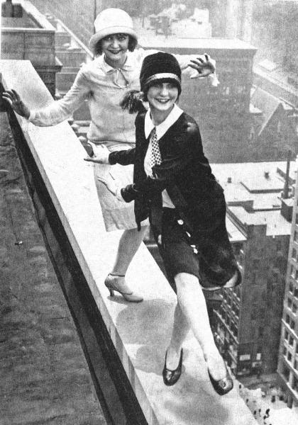
Document A

Slide 5
Document A

Slide 6
Document A

Slide 7
Document F
Notes:
Girl at the Sewing Machine, 1927

Slide 8
Document F
Notes:
Automat, 1927

Slide 9
Document F
Notes:
Chop Suey, 1929

