Slide 1
Bell Ringer: Checklist
Where are you with the following assignments?
  Top Ten Identifications
    You should be finished with Period 1
  Key Concept Graphic Organizers
    You should be finished with Period 1
  Brinkley Text Readings
    You should be finished with Chapter 2
    Chapter 3, begin tonight
  Colonial Brochure due 9/20

Slide 2
American Colonial Society in the 18th Century
​Key Concept 2.2 The British colonies participated in political, social, cultural, and economic exchanges with Great Britain that encouraged both stronger bonds with Britain and resistance to Britain’s control

Slide 3
Colonial Economics & Politics
To what extent had the American colonies collectively developed self-rule and a democratic society between 1607 and 1754?

Slide 4
Commerce and Trade
The British Empire was based on mercantilism.
  The empire sought economic self-sufficiency and a favorable balance of trade with rival empires.
  The colonies existed solely for the benefit of the mother country.
  Parliament passed hundreds of Navigation Laws to regulate its mercantilist empire.
    1651, the first Navigation Act was passed during Oliver Cromwell’s “Protectorate” which sought to prevent Dutch trade with the American colonies.
    England banned colonial trade with any other country except England.

Slide 5
Commerce and Trade
    Navigation Act of 1663, all goods shipped from Europe to the American English colonies first had to go through England for tax purposes.
    Navigation Act of 1673, England imposed taxes on coastal trade among the colonies and appointed customs agents to enforce the Navigation Laws.
    Later laws such as the Wool Act, Iron Act, and Hat Act sought to reduce colonial production and/or exportation of goods that would either pose competition to British manufacturers or evade taxation by the empire.
    Certain "enumerated" articles like tobacco could only be shipped to England, despite higher prices that the colonists could receive in other foreign markets.

Slide 6
Triangular Trade: Atlantic Slave Trade Model
a. New England rum was shipped to Africa.
b. Ships were then filled with slaves and sent to the West Indies.
c. Molasses and some slaves sailed to British North America where ships were unloaded and reloaded with rum.

Slide 7
Triangular Trade: Classical Model
  a. Britain shipped textiles, rum, and manufactured goods to Africa.
  b. Slaves were transported to the West Indies and North America.
  c. Goods from the West Indies and North America, such as sugar, tobacco, lumber, cotton goods, were shipped to Britain

Slide 8
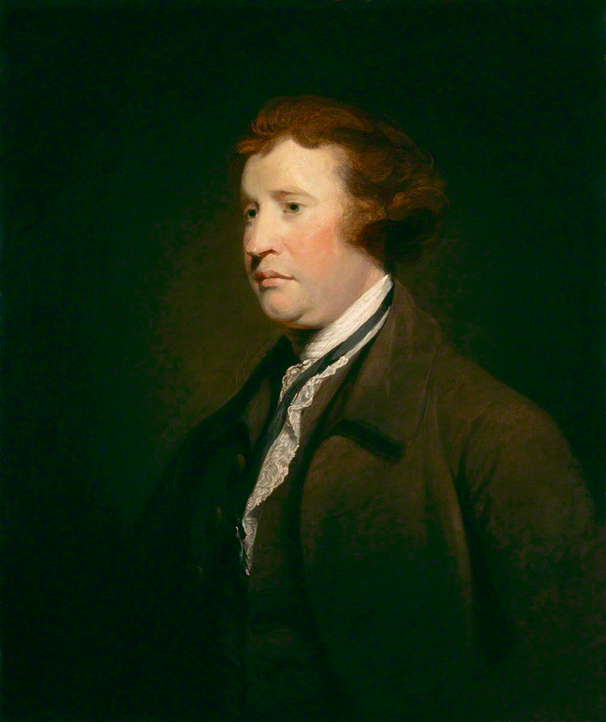
Illegal American colonial trade
A period of “salutary neglect” from c. 1713 to 1763 enabled Americans to trade without much regulation by the British Empire.
  The term comes from Edmund Burke's "Speech on Conciliation with America" given in the House of Commons March 22, 1775.

Slide 9
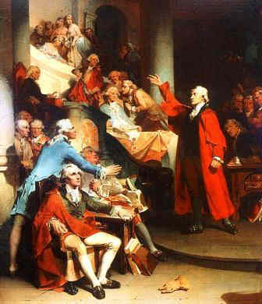
Salutary Neglect
Policy was an intentional lack of enforcement by the British government of British trade laws in the American colonies
Meant to keep the American colonies obedient to Great Britain
The colonists were left to govern themselves. These essentially sovereign colonies soon became accustomed to the idea of self-control or self-rule.
The effects of such a long period of isolation resulted in a collective identity of the colonists that considered itself separate from Great Britain.

Slide 10
Illegal American Colonial Trade
American trade Increased with England and others during salutary neglect
  Growth of the American population created an increased demand for British goods.
  Navigation Acts were passed to ensure trade to meet that demand
  But as the American economy grew, Americans sought other foreign markets and resisted the Navigation Acts.
    Exports to France and the French West Indies brought in money for colonists to buy British goods.
    In response, the British passed the Molasses Act, 1733: Britain sought to stop colonial trade with the French West Indies
      Colonists ignored the act and it was typical of how Navigation Laws aimed at the American colonies were often not obeyed.

Slide 11
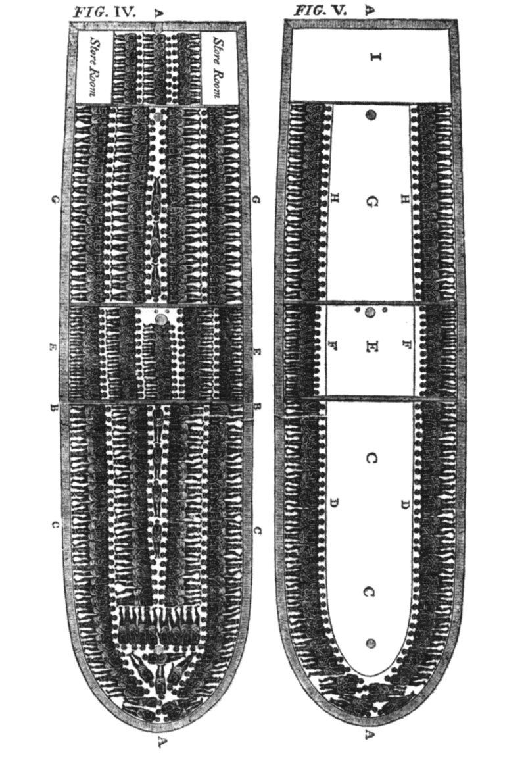
Illegal American Colonial Trade
New England exported timber, fish, cotton goods, and light manufacturing to the French Caribbean for molasses.
New England ships illegally brought French molasses back home to be distilled for rum production.
  Rhode Island became the center for rum distillation in the colonies.
Rum from New England was shipped illegally to the French West Indies where slave ships that had disposed of their human cargo took rum to the Gold Coast of Africa.
Slaves transported via the Middle Passage to the colonies (e.g. Newport, RI) but some of the trade came from non-British ships.

Slide 12
Colonial Manufacturing
Secondary in importance to farming.
Lumbering, mining, fishing, and shipbuilding became the most important industries during the 18th century.
Small industries existed such as tailoring, shoemaking, baking, metalworking, and furniture making.
  Due to competition with English manufacturing, The Iron Act of 1750 placed further restrictions on colonial metal production.
Wool: female spinners and weavers at home produced a large output of cloth.
  Wool Act of 1699 forbade exportation of colonial wool or wool products and imposed a tax on wool products imported into the colonies.
Other enterprises included naval stores, beaver hats, rum, carpentry

Slide 13
Agriculture
Agriculture remained vital to trade in the Middle and Southern colonies.
  Grain was exported from the mid-Atlantic colonies (the “bread colonies”)
  Tobacco from the Chesapeake (Virginia and Maryland) and North Carolina was shipped to Britain.
  Rice and indigo from South Carolina and Georgia were shipped to Britain or to the Caribbean where rice fed the large slave population that worked in sugar cane fields.

Slide 14
Political Structure of the Colonies by 1775
Royal Colonies: Ten colonies had royal governors appointed by the crown and were more closely regulated by Britain.
Proprietary Colonies: Pennsylvania was the only remaining proprietary colony on the eve of the revolution.
  Initially, Maryland, Carolina and Georgia had been proprietary.
Charter/Corporate Colonies: Connecticut and Rhode Island elected their own governors under self-governing charters.

Slide 16
Development of Republicanism
Republicanism: representative government where people elect their own representatives to protect their interests.
Bicameral legislatures were most common among the 13 colonies.
  a. Upper house, or Council: normally appointed by the crown or Proprietor
  b. Lower house, or Assembly: elected by property owners (the people)
    Voted for taxes to pay the expenses of the colonial government
    Because there were more property owners per capita in the colonies than anywhere else in the world, the colonies were, in effect, the most democratic region anywhere.

Slide 17
Nature of American politics
Colonial governments did not enjoy the power that Parliament enjoyed.
Yet, colonial governments were far more reformed than those in England.
    a. Much more direct representation; the will of the people was more effectively expressed.
    b. Less corruption
Administration at the local level
    a. New England: town hall meetings
    b. South: county government
    c. Middle colonies: combination of the above
Voting restrictions
    a. The upper class opposed democracy as they did not trust the common people.
    b. Property and/or religious qualifications were imposed.
    c. As much as 50% of white males were disenfranchised.

Slide 18
Royal Governors
Held Legal power (in theory)
  Had authority to exercise veto power over colonial legislation
  Had power to dissolve lower houses of colonial assemblies
  Had power over the judiciary in the colonies
In reality, governors were weak in many respects.
  Assemblies often controlled governors’ salaries.
    Governors sometimes did not get paid because they governed contrary to the wishes of the colonial legislature.
  The king's orders were often strict and ineffective as Britain was 3,000 miles away.
  Governors suffered from a lack of money from supporters.
  Assemblies had powers to fill government positions in most colonies; this reduced the influence of governors.
  Towns instructed their representatives how to vote which was often contrary to the wishes of governors.

Slide 19
Development of Democratic Ideals in Colonial America
Democratic ideal of tolerance emerged
Higher educational advantages compared to Europe
Equality of opportunity much more evident than in Europe
Freedom of speech and the press
Freedom of assembly
Representative government

Slide 20
Bibliography
College Board, AP United States History Course and Exam Description (Including the Curriculum Framework), 2014: History, New York: College Board, 2014
Bailyn, Bernard, The Origins of American Politics, New York: Vintage Books, 1968 _____________, The Ideological Origins of the American Revolution, Cambridge, Massachusetts: Belknep, 1967
Brinkley, Alan, Williams, T. Harry, and Current, Richard N., American History, 14th Edition, New York: McGraw-Hill, 2012
Cook, Don, The Long Fuse: How England Lost the American Colonies, 1760-1785, New York: Atlantic Monthly Press 1995
Foner, Eric & Garraty, John A. editors: The Reader’s Companion to American History, Boston: Houghton Mifflin Company, 1991
Hofstadter, Richard, America at 1750: A Social Portrait, New York: Vintage Books, 1971
Kennedy, David M., Cohen, Lizabeth, Bailey, Thomas A., The American Pageant (AP Edition), 13th edition, Boston: Houghton Mifflin 2006
Murrin, John, et al., Liberty Equality and Power: A History of the American People, Ft. Worth: Harcourt Brace 1999
Nash, Gary : American Odyssey, Lake Forest, Illinois: Glencoe, 1992 Wikipedia Commons, maps of the Triangular Trade

Slide 21
Colonial Brochure
Continue research and creation of your Colonial Brochure
Gallery Walk Directions

